Slide 1



Deborah Kozdras:
dkozdras@usf.edu
USF Stavros Center
Jodi B. Pushkin jpushkin@tampabay.com
Tampa Bay Times NIE
Thank-you to State Farm for generously sponsoring this workshop.

Slide 2
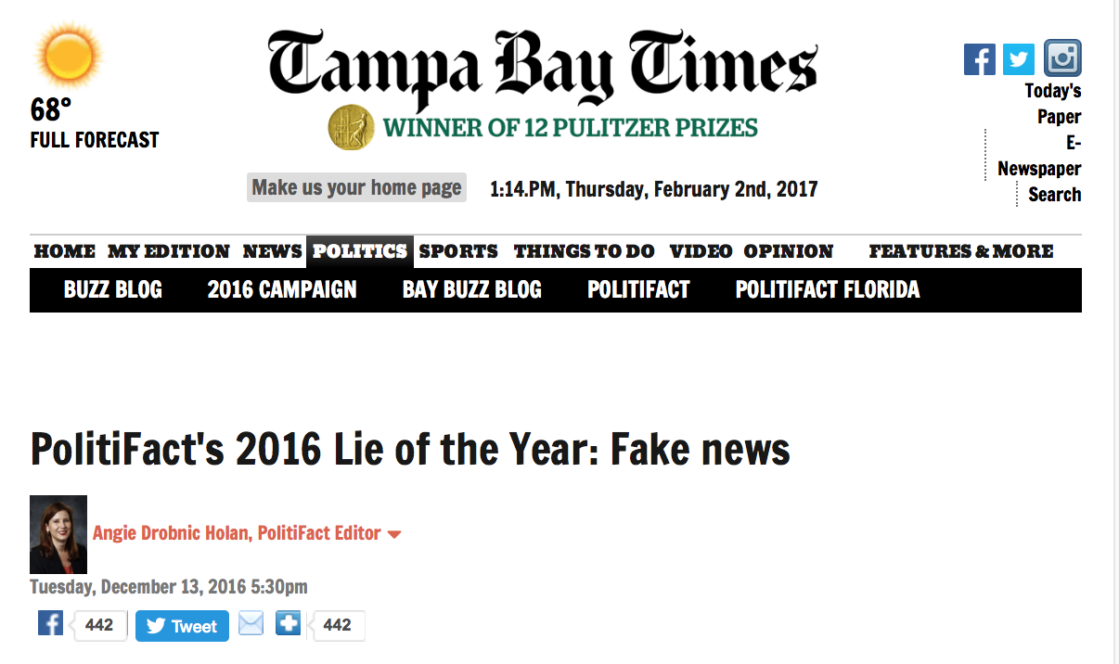
http://www.tampabay.com/news/politics/national/politifacts-2016-lie-of-the-year-fake-news/2306159

Slide 3
“All our reporters have an editor who supervises them. The number of reporters an editor supervises varies but generally it’s between four and seven people. When a reporter writes a story, their editor reads it thoroughly, asks questions, edits for grammar, spelling, clarity and facts, often asking a reporter where they got a piece of information and questioning something if it seems not to make sense. They check names, dates or other facts as well. After the supervising editor finishes the story, it is sent to the copy desk, where at least one copy editor and sometimes two will also read the story, checking facts (such as names, places, math) and raising questions if something seems amiss or suspicious in a story. That’s the process that we go through for most routine stories.
“If the story is highly complex or significant, or we plan to run it on the front page, especially the Sunday front page, it will almost always go through additional layers of editing. The first editor’s supervisor might read it, and on many occasions. I will review the story or our executive editor will. Stories that are running on the Sunday front page (our most read addition) are always read by an assistant managing editor and either me or the executive editor.
“The process is somewhat compressed when breaking news is published online. If the story is one that is ongoing and developing -- someone has just been arrested on a murder charge – the reporter will write the article and we have an editor read it before publication. Sometimes that is not their supervising editor but another trusted editor who is free at the moment the story needs to be published. After the story goes online, it is updated throughout the day by the reporter, re-edited by their editor and then when the story is not going to be updated any more before print publication, it goes through the editing process above, where it gets a final read from the assigning editor and goes to be read by the copy desk.”
-- Jennifer Orsi, managing editor Tampa Bay Times

Slide 4
Why do we get hooked into spreading dubious claims?
What happens when we are surfing the net?
What happens when we surf our news feeds?
What happens when we surf Facebook?

Slide 5
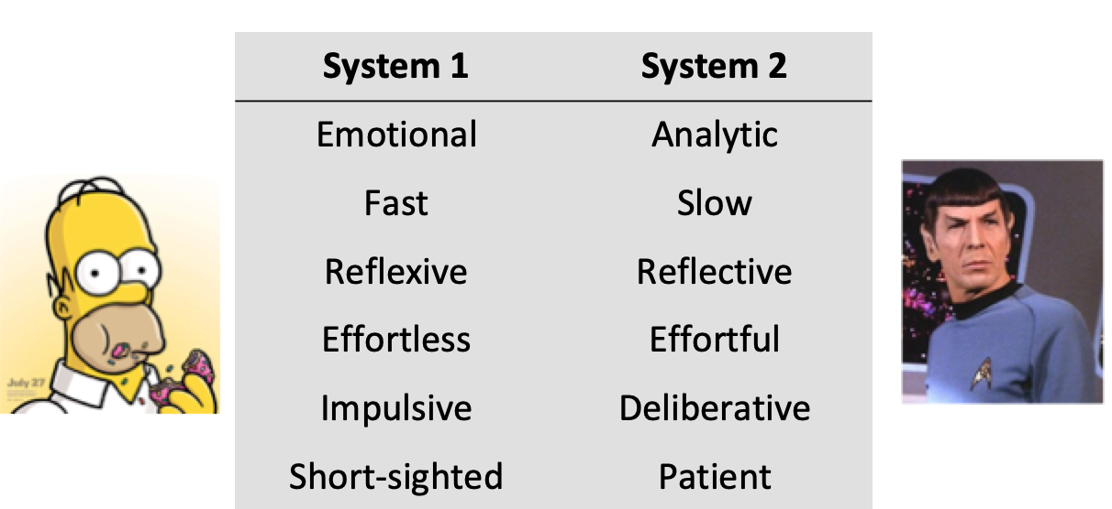
Thinking Fast and Slow by Daniel Kahneman
Doesn’t realize bias
Doesn’t always recognize own cognitive biases

Slide 6
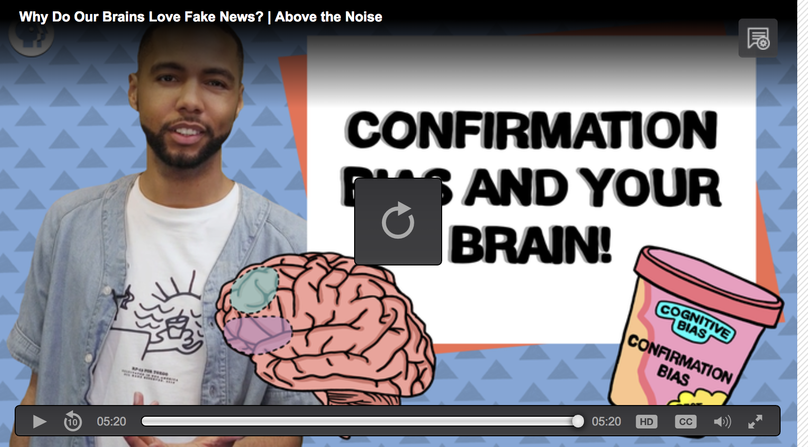
Recognize Your Biases
https://www.pbslearningmedia.org/resource/bias-brain-kqed/why-do-our-brains-love-fake-news-above-the-noise/?#.W4BO_dPwZBx

Slide 7
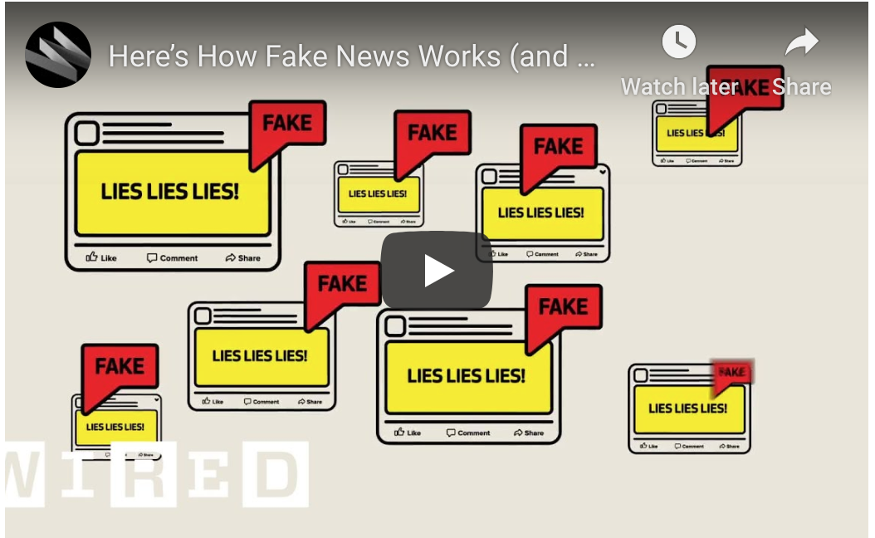

Slide 8
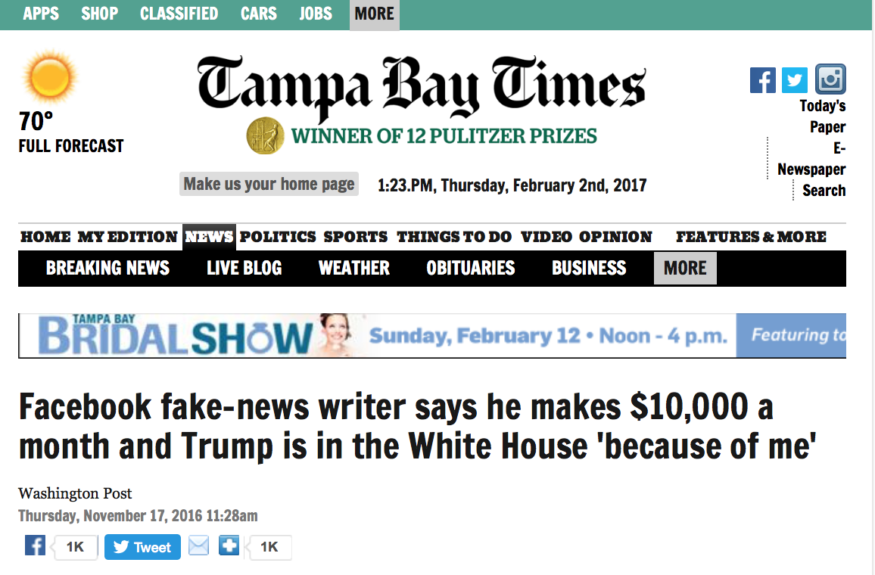

Economics: Why Do They Do It?
Notes:
Other fake news had less convoluted origins. Paul Horner runs a string of websites, some looking deceptively like mainstream news organizations. He created a post that said protesters at Trump rallies were paid $3,500 to disrupt the rally as a dirty tricks plot. He told the Washington Post he knew it wasn't true but wrote it as a parody that could make him money if people actually believed it. "I just wanted to make fun of that insane belief, but it took off," he said.
What happened next is classic: Trump himself repeated the claim about paid protesters at a rally.

Slide 9

The Economics of Why They Do It
Monetary Benefits + Psychological Benefits
>
Psychological Costs of Committing the Crime
+
Monetary Opportunity Costs
Probability of arrests and convictions
(Expected Penalty Effect)
http://wmcyberintrusion.info/wp-content/uploads/2017/11/FakeNews2017.pdf

Slide 10
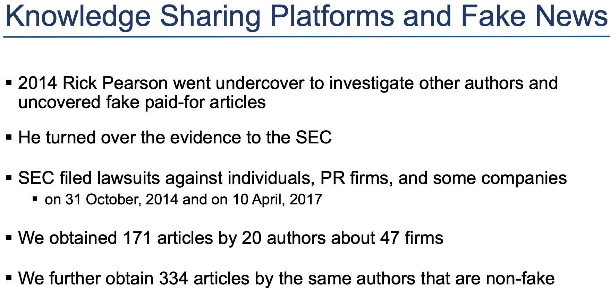
Fake News in Finance Study
https://www8.gsb.columbia.edu/financialstudies/sites/financialstudies/files/FakeNews_Niessner_NewsConf.pdf

Slide 11
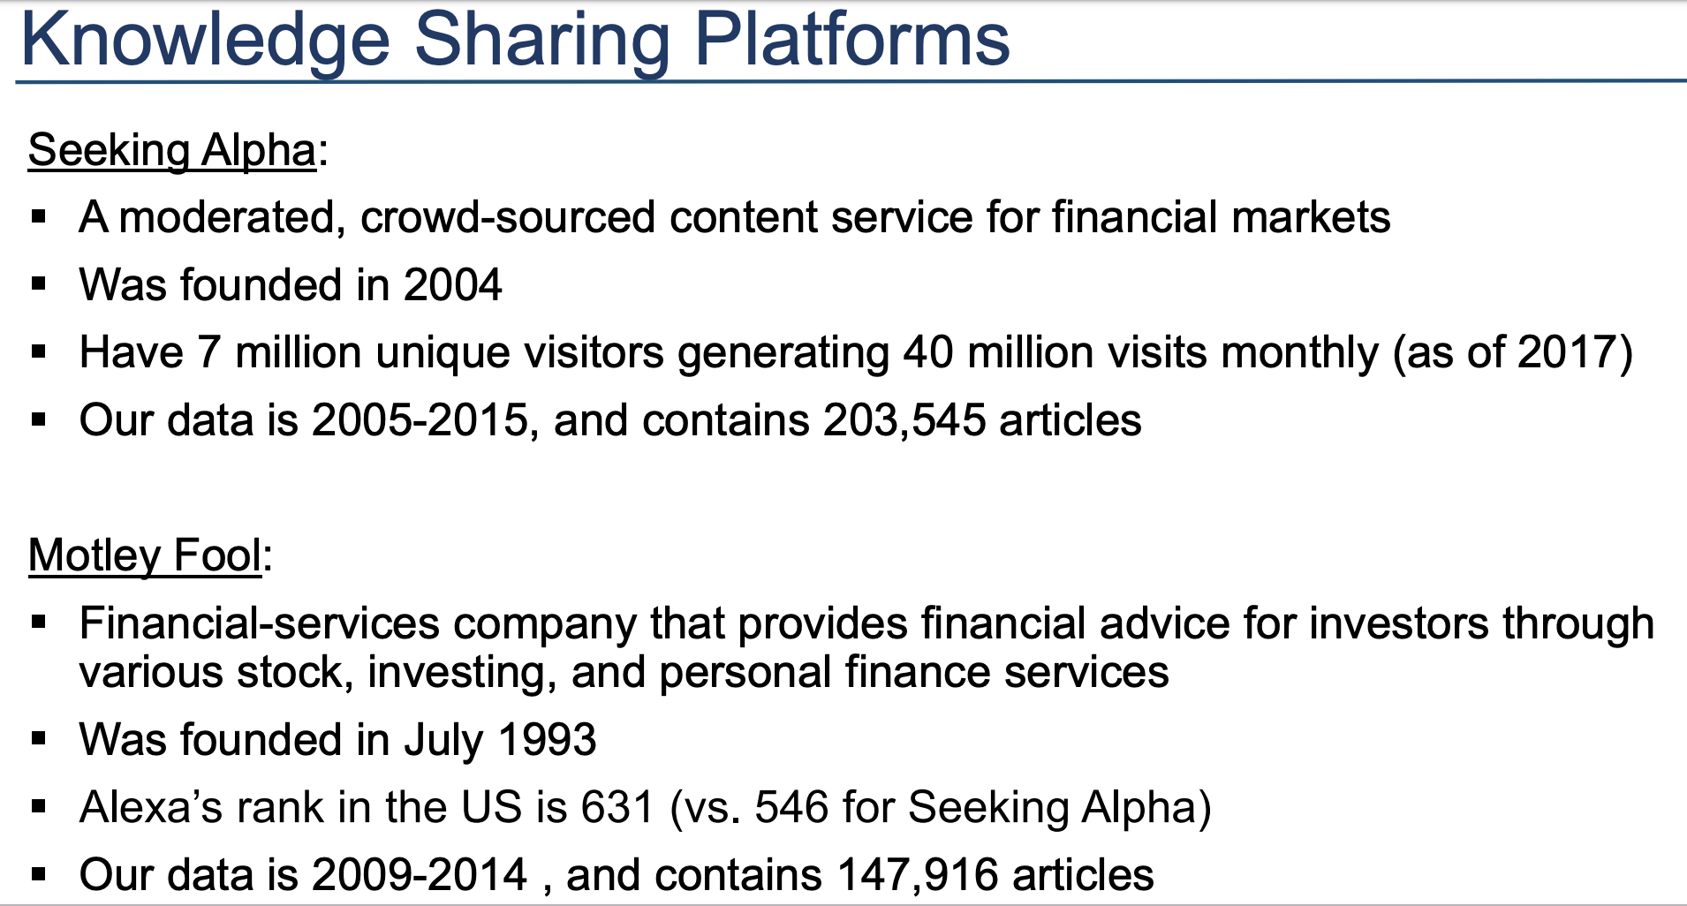
Fake News in Finance Study
https://www8.gsb.columbia.edu/financialstudies/sites/financialstudies/files/FakeNews_Niessner_NewsConf.pdf

Slide 12
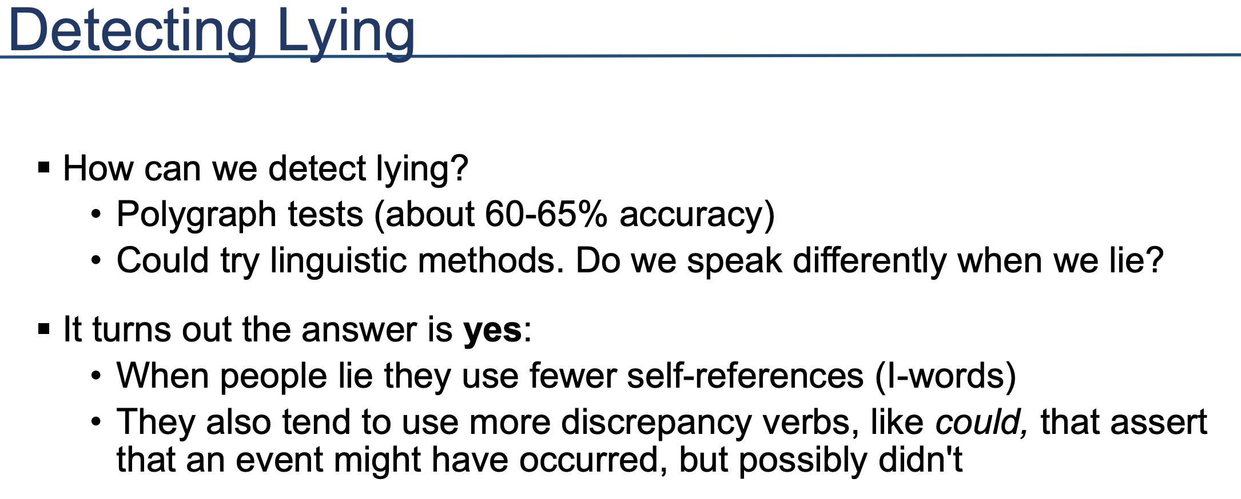
Fake News in Finance Study
https://www8.gsb.columbia.edu/financialstudies/sites/financialstudies/files/FakeNews_Niessner_NewsConf.pdf

Slide 13
Results . . .
After fake news:
  Small firm stock prices increased by an average of 7% over 6 months and then dropped.
  Medium Firm Prices decreased 5% over 10 months.
Who wrote the articles?
  In small firms articles appeared at the same time as press releases and insider trading, suggesting an inside job!
  No link with larger firms, suggesting individual investors wrote the fake news.
Fake news impacted public trust.

Slide 14
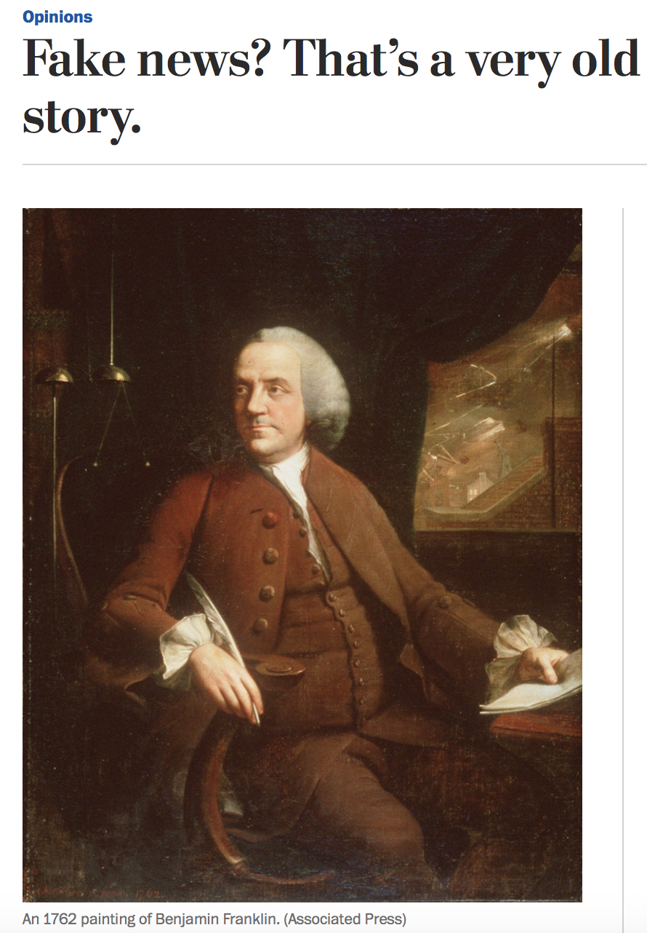
https://www.washingtonpost.com/opinions/fake-news-thats-a-very-old-story/2016/11/25/c8b1f3d4-b330-11e6-8616-52b15787add0_story.html?utm_term=.de1971e180cc

Slide 15
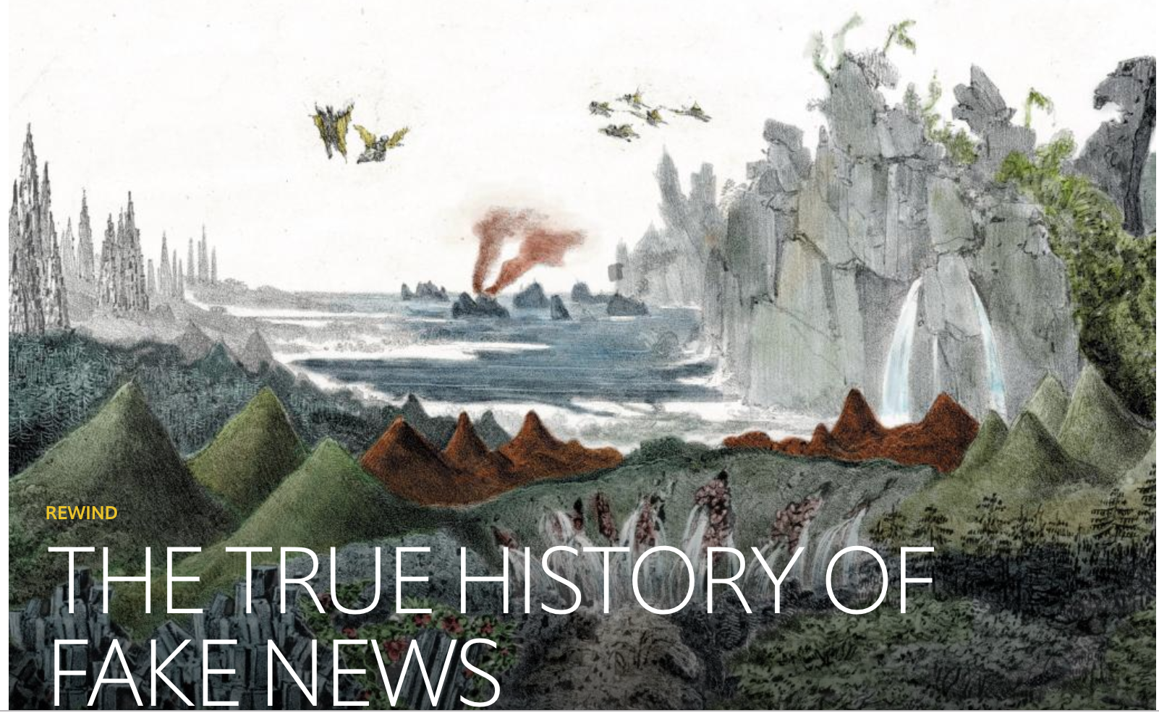
From Unicorns on the Moon to Fairies in England!!
https://www.1843magazine.com/technology/rewind/the-true-history-of-fake-news

Slide 16
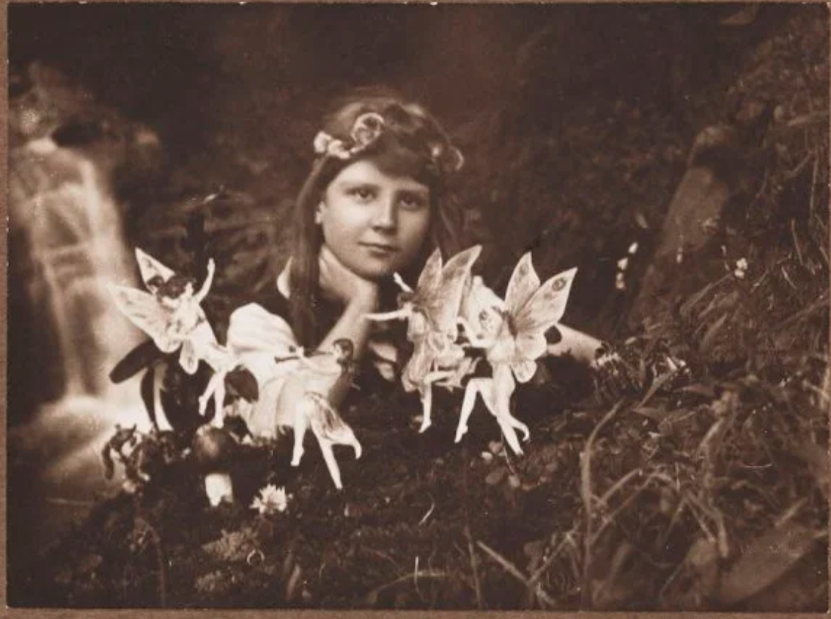
https://time.com/4876824/cottingley-fairies-book/

Slide 17
Yellow Journalism & the Yellow Kid:
Spanish-American War, 1890’s, & Hearst vs. Pulitzer
https://cartoons.osu.edu/digital_albums/yellowkid/1895/1895.htm

Slide 18
From Yellow Journalism to Click Bait
R.F. Outcault

Slide 20
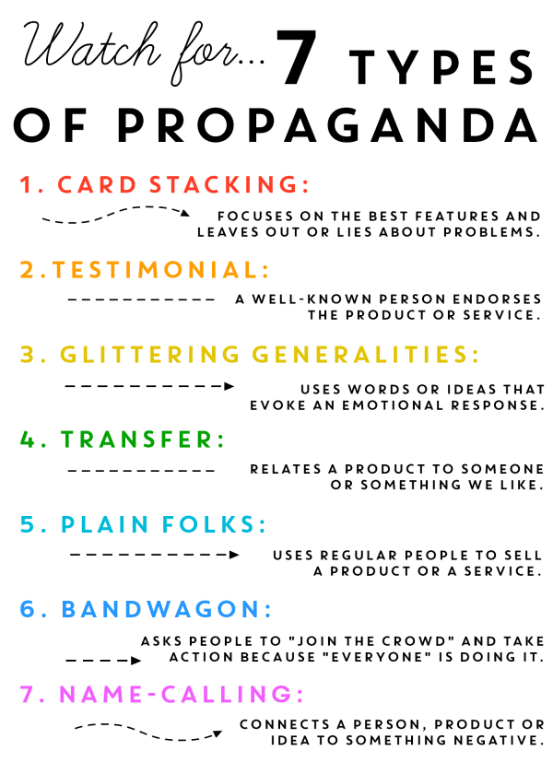
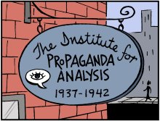
http://www.propagandacritic.com/

Slide 21
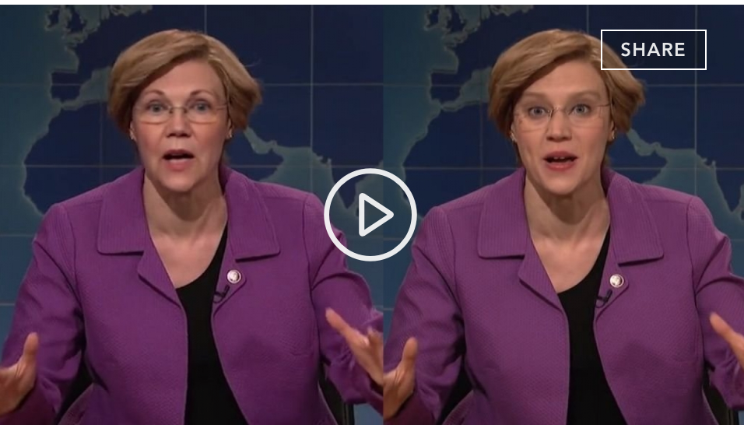
Propaganda + Deepfakes = ?

Slide 22
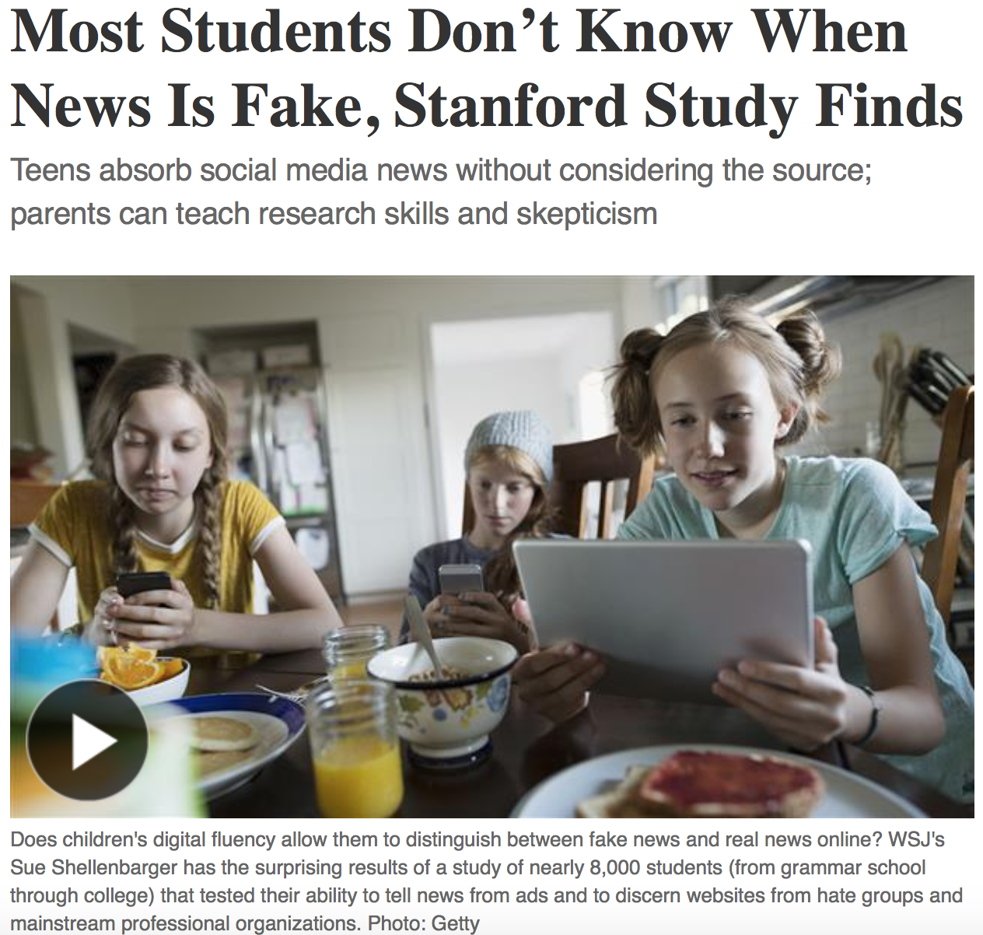

Problem →
Read T

Slide 23
Fact Checking and Lateral Literacy
Use on-the-record interviews
Publish a list of sources with every fact-check.
Attempt to contact the person, website or organization
Emphasize primary sources and original documentation.
https://www.politifact.com/truth-o-meter/article/2018/feb/12/principles-truth-o-meter-politifacts-methodology-i/

Slide 24
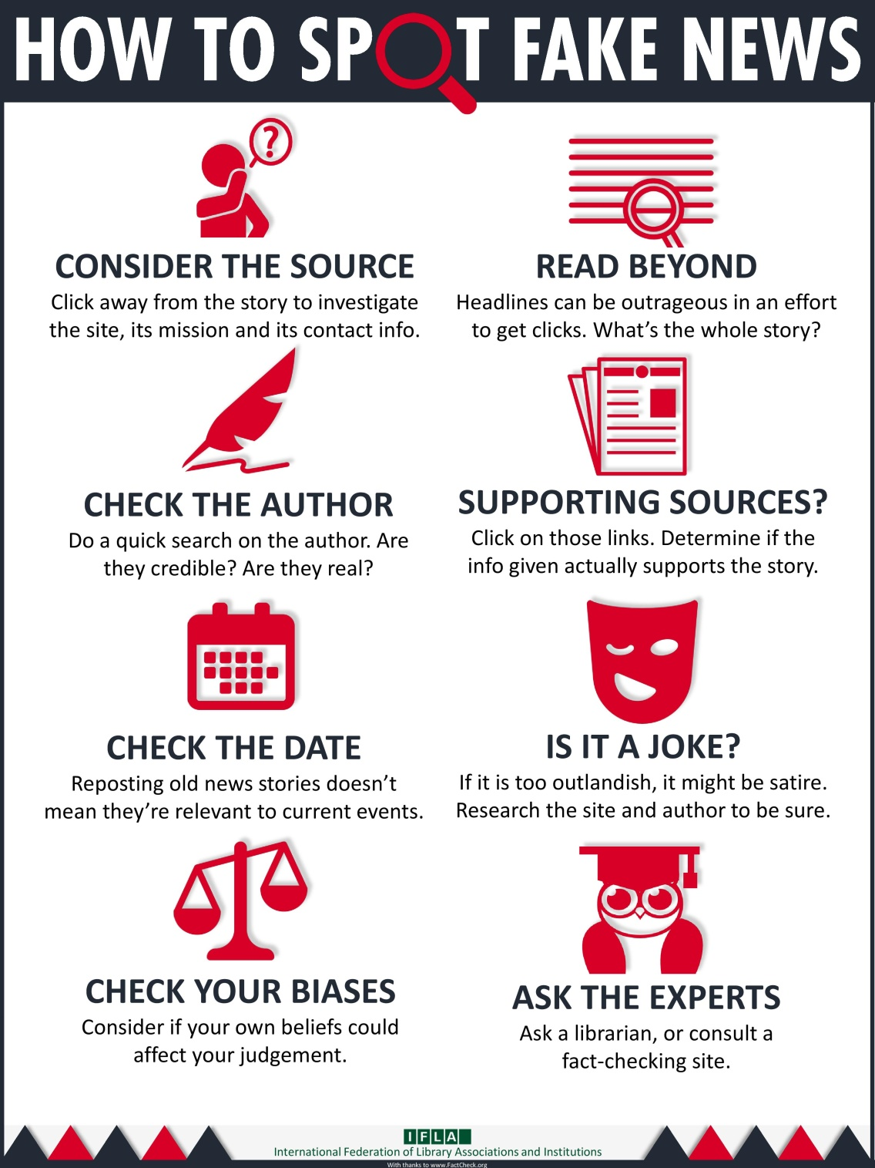
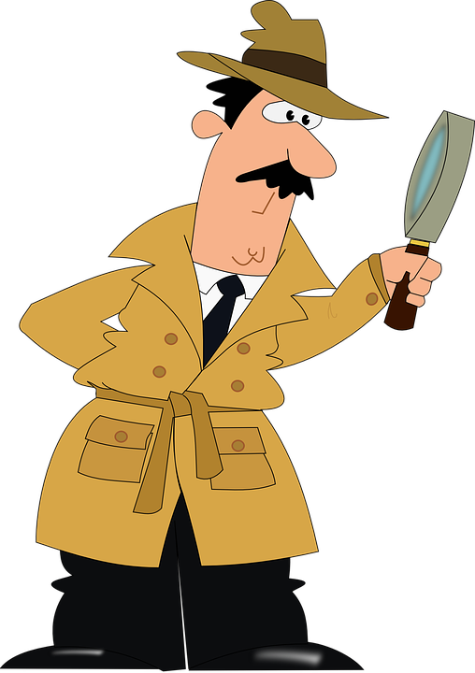
Notes:
What's wrong with fake news?
Why should you care about whether or not your news is real or fake?
You deserve the truth. You are smart enough to make up your own mind - as long as you have the real facts in front of you. You have every right to be insulted when you read fake news, because you are in essence being treated like an idiot.
Fake news destroys your credibility. If your arguments are built on bad information, it will be much more difficult for people to believe you in the future.
Fake news can hurt you, and a lot of other people. Purveyors of fake and misleading medical advice like Mercola.com and NaturalNews.com help perpetuate myths like HIV and AIDS aren't related, or that vaccines cause autism. These sites are heavily visited and their lies are dangerous.
Real news can benefit you. If you want to buy stock in a company, you want to read accurate articles about that company so you can invest wisely. If you are planning on voting in an election, you want to read as much good information on a candidate so you can vote for the person who best represents your ideas and beliefs. Fake news will not help you make money or make the world a better place, but real news can.

Slide 25




Sites that get paid to do this leg work for you:
FACT CHECKING
FactCheck.org
Politifacts.com
Washington Post Fact Checker
Snopes.com
USAFacts.org (beta)
Allsides

Slide 26





FACT CHECKING - Continued
OpenSecrets.org
Poynter.org
Factitious
OpenSources.co
TinEye
SBrowning.com - WhoWhatWhen
Notes:
OpenSecrets.org - Nonpartisan, independent and nonprofit, the Center for Responsive Politics is the nation's premier research group tracking money in U.S. politics and its effect on elections and public policy.
Poynter - founded the International Fact-Checking Network in 2015 and is the leading convener, teacher and community-builder for fact-checkers around the world.
Facticious - http://factitious.augamestudio.com/#/
OpenSources.co - document created by Melissa Zimdars, assistant professor of communication and media at Merrimack College in North Andover, MA because she saw her students referencing questionable sources, she created and shared this document with them of how to think about sources, as well as a list of misleading, satirical and fake sites.
TinEye - Search by image and find where that image appears onlineSearch by image and find where that image appears online
WhoWhatWhen -WhoWhatWhen is a database of key people and events from 1000 A.D. to the present. Create graphic timelines of periods in history and of the lives of individuals. - The database consists of famous people and famous events. People entries consist of the name, short description, which category they were famous for, and birth and death dates. No detailed biographical info is in this database, but this site will provide links to popular web search engines which will give you in depth information about each person or event. While people from all over the globe are included, there is a definite "American" slant to the entries. Dates go from around 1000 AD to the present. Only people with a known year of birth and death are entered. Famous composers, scientists, political figures, writers, etc... make up most of the entries before 1900. After that, a lot of "popular culture" figures are in the database.
Nonpartisan, independent and nonprofit, the Center for Responsive Politics is the nation's premier research group tracking money in U.S. politics and its effect on elections and public policy. Nonpartisan, independent and nonprofit, the Center for Responsive Politics is the nation's premier research group tracking money in U.S. politics and its effect on elections and public policy.

Slide 27
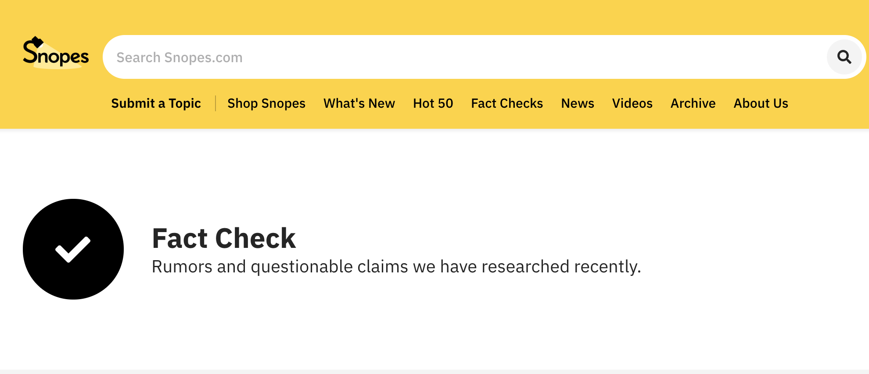

Slide 28

American Press Institute:
Critical questions for interpreting media
Type: What kind of content is this?
Source: Who and what are the sources cited and why should I believe them?
Evidence: What’s the evidence and how was it vetted?
Interpretation: Is the main point of the piece proven by the evidence?
Completeness: What’s missing?
Knowledge: Am I learning every day what I need?

Slide 29

We all need to be news detectives…

Slide 30

Key Questions to Ask:
Who made the message?
Who is the target audience (how do you know)?
Who paid for this? Or who gets paid if you read or respond to this message?
Who might benefit or be harmed by this?
What important info is left out or missing?
Is this credible (and what makes you think so)?
Is the main point proven by verifiable evidence?

Slide 31
Identify the source!
Look for a byline – who wrote it?
  Is this a real person? More importantly, are they credible?

Slide 32
Identify the source!
Look for a byline – who wrote it?
Is this a real person? More importantlyare they credible?
Who owns the webpage?
Who originally wrote or said the information being referenced?
Who took the photo/video images?
Are they timely? Have they been changed/edited?
(TIP: Using a reverse image search on Google can give you an idea of whether the image is real.)

Slide 33
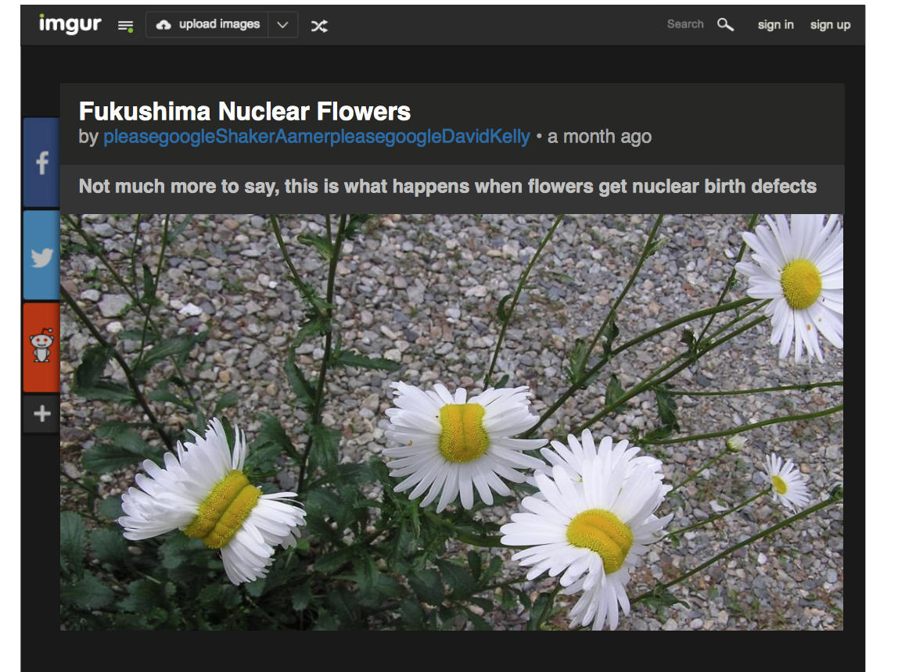
Does this image present strong evidence for toxic conditions near the
Fukushima nuclear plant in Japan?
Notes:
Nearly four in 10 high school students believed, based on the headline, that this photograph of deformed daisies provided strong evidence of toxic conditions near the Fukushima Daiichi nuclear plant in Japan, even though no source or location was given for the photo.

Slide 34
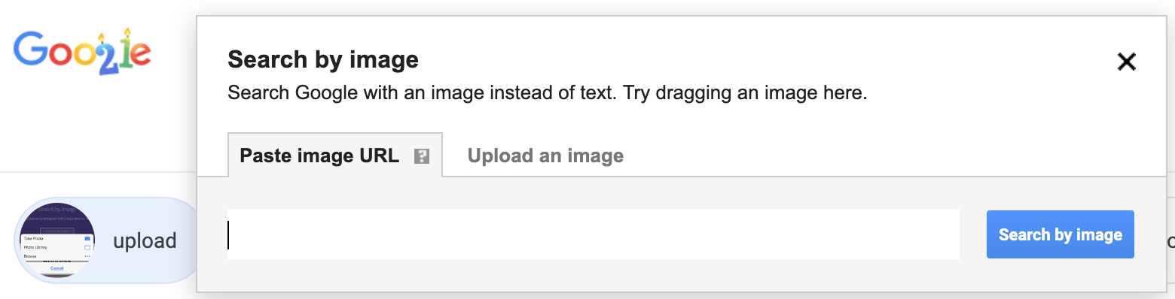
Reverse Image Search

Slide 35
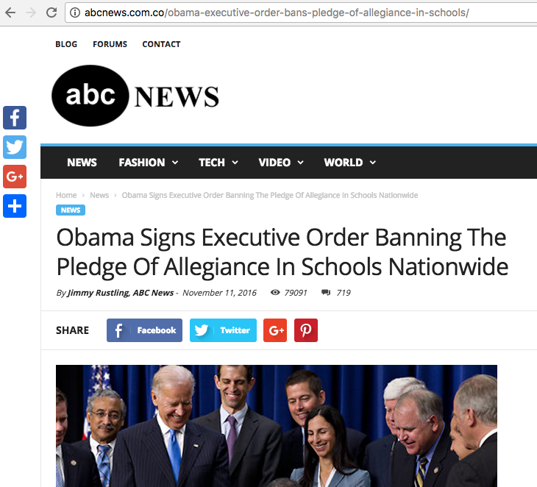

Slide 36

Common Sense Media Video

Slide 37
Double check
the URL

Slide 38


Tampabay.com/nie

Slide 39
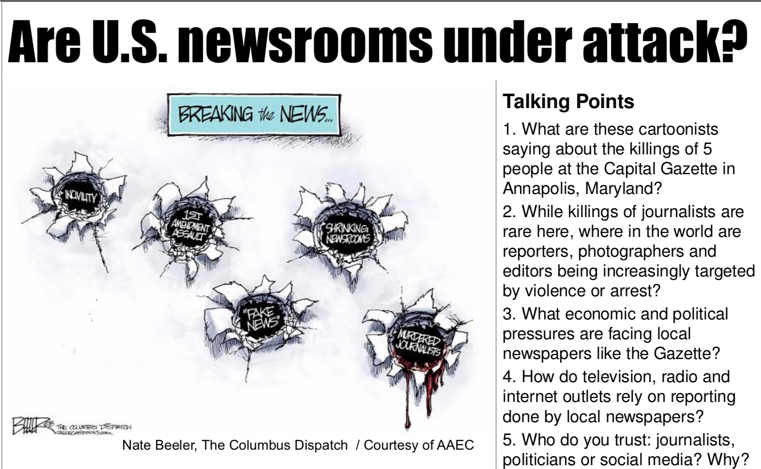

Slide 40
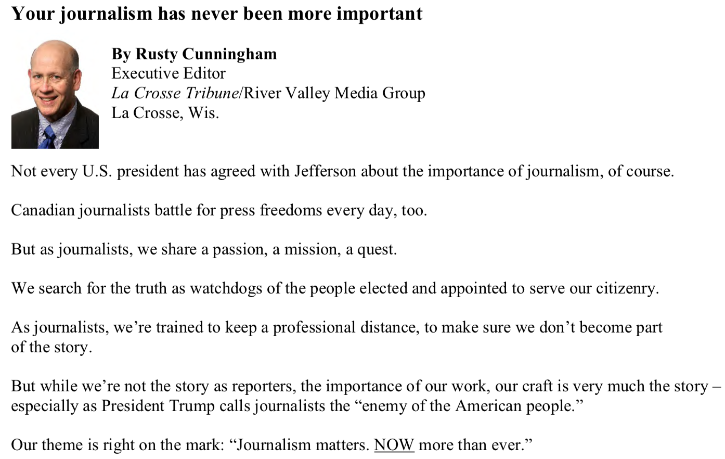

Slide 41
Times NIE services
The Tampa Bay Times Newspaper in Education program provides free resources to Citrus, Hernando, Hillsborough, Manatee, Pasco and Pinellas counties.
  The TBT NIE provides newspapers, electronic licenses and curriculum guides to classrooms around Tampa Bay each year
  TBT NIE hosts teacher workshops
  TBT NIE provides teachers with free lesson plans in print and online – www.tampabay.com/nie.

Slide 42

Using the Digital Edition
You and your students can read the Tampa Bay Times, just as it appears in the printed edition, from the convenience of your computer, phone, tablet or electronic reading device.
  Classwork
  Homework
  Research
  Writing models
  Grammar and math exercises

Slide 43
Accessing the Digital Edition
  Teachers, students, and parents should use the same user name and password:
    Go to tampbay.com/nie
    Click log in here
    Enter user name
    Enter password
    Select preferred edition
    Click remember me box
    Click Log in

Slide 44
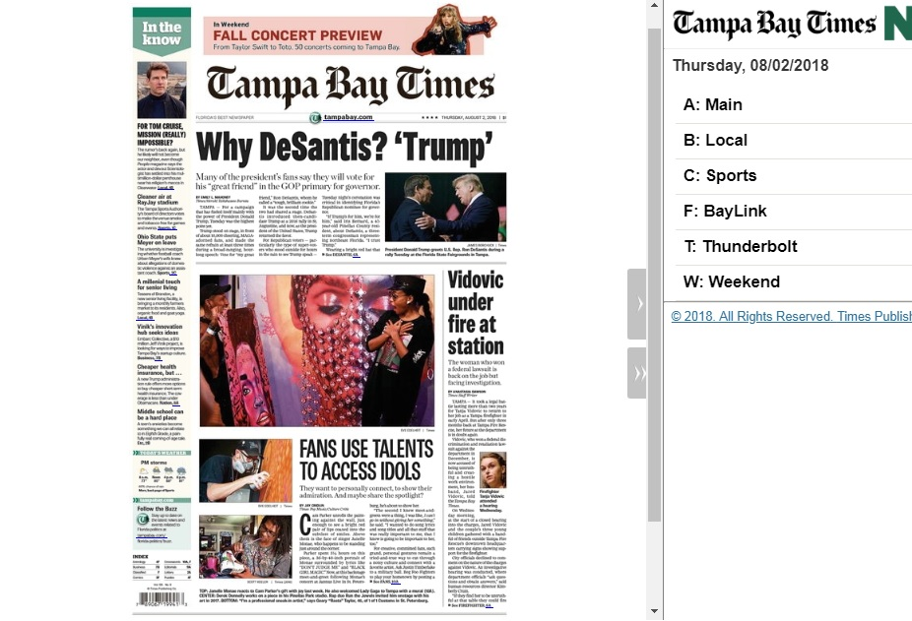

Slide 45
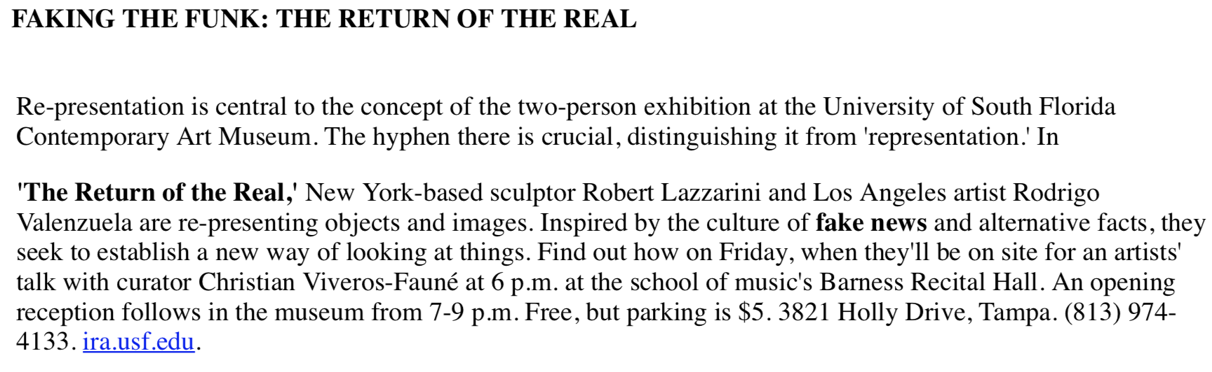
How would you design an exhibit?

Slide 46
Deborah Kozdras
dkozdras@usf.edu
Office: 813-974-2175
Website USF Stavros: https://www.usf.edu/education/stavros-center/
  Click on resources
  Click on USF Stavros Resources
Social Media:
@usfstavros (Twitter, Facebook, Instagram)
Jodi Pushkin, manager
jpushkin@tampabay.com
Office: 727-893-8961
Website for NIE: tampabay.com/nie
Social Media:
Twitter.com/TBTimesNIE
Facebook.com/TBTNIE

