Slide 1
&
ALL HIGH SCHOOL STUDENTS SHOULD BE TAUGHT BASIC FINANCIAL EDUCATION.

Slide 2
WHEN you open the folder… it looks like this :)
3-5 6-8 9-10 11-12 K-2
SLIDES
Slides LIST Resources <some linked>!!!
*Use the slides to make a list of what lesson you are looking for in the appropriate folder!
*** Not only are some docs listed here… BUT there multiple folders for grade levels! Please be careful not to miss resources! ;)

Slide 3
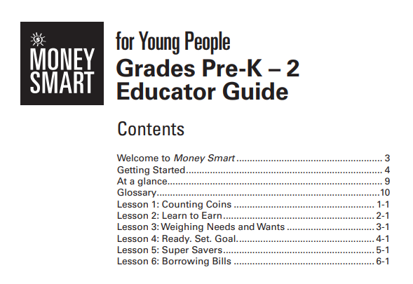
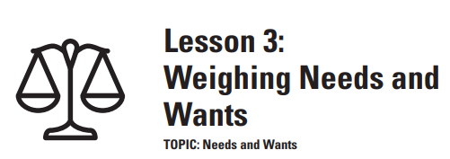
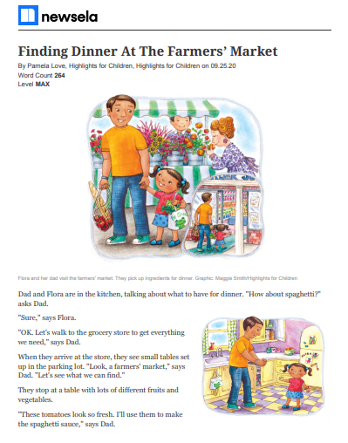
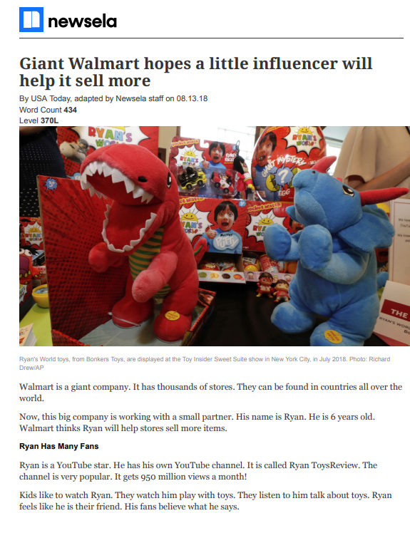
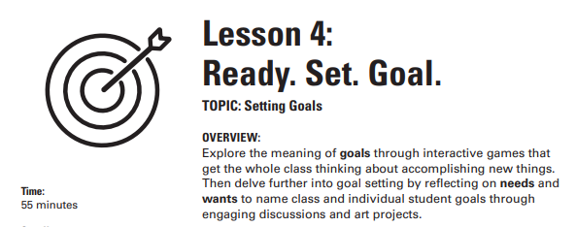
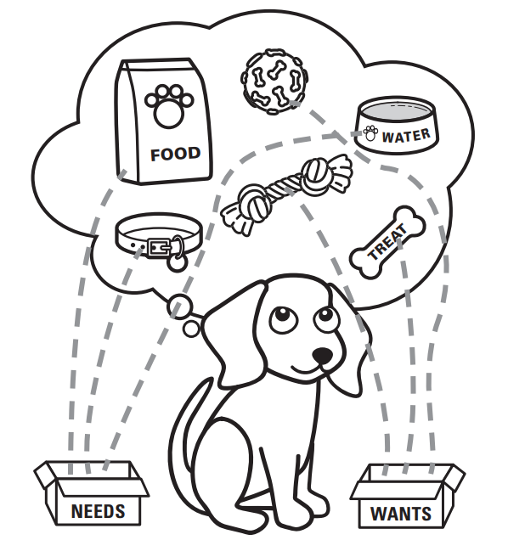
Budgeting
K- 2
Lesson 3: Weighting Needs and Wants
Lesson 4: Ready. Set. Goal. <choices between needs vs wants: goals>
Newsela Articles Check Lexile Levels!

Slide 4
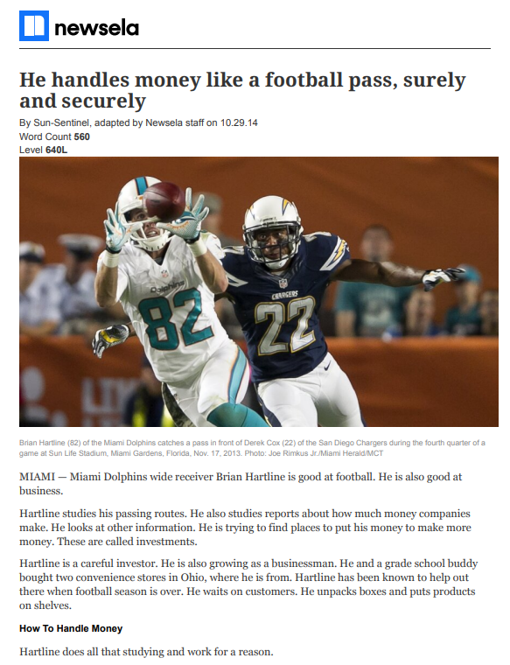
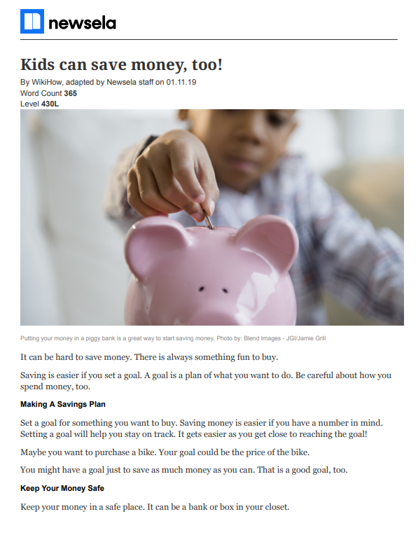
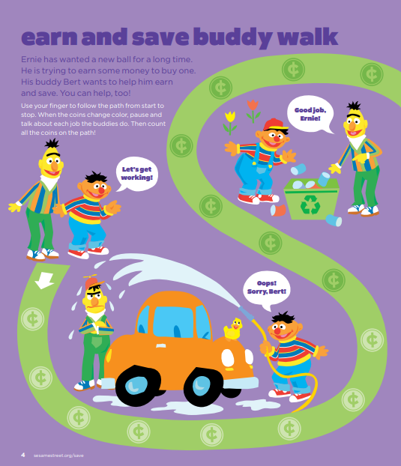
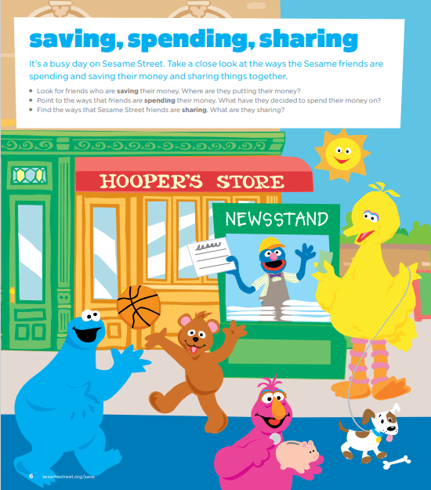
Saving
K- 2
Lesson 5: Super Saver
Newsela Articles Check Lexile Levels!
Sesame Street: Save, Spend, Share

Slide 5
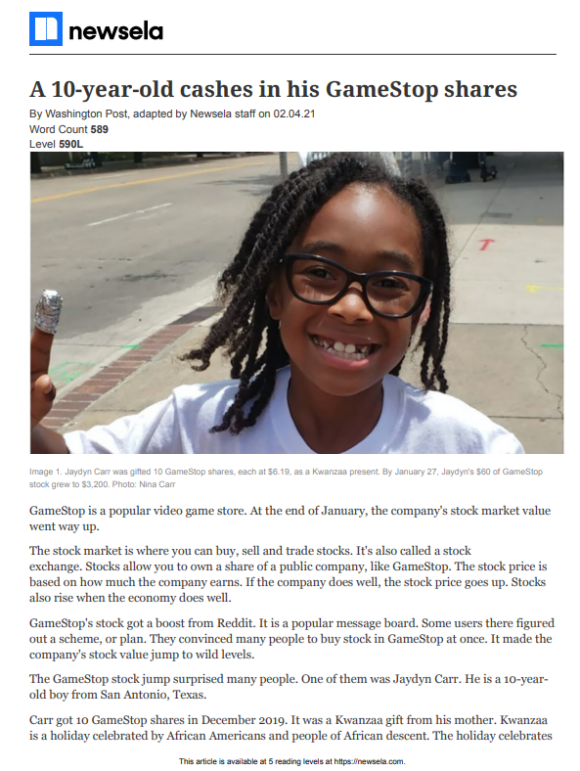
Investing
K- 2
Newsela Articles Check Lexile Levels!

Slide 6
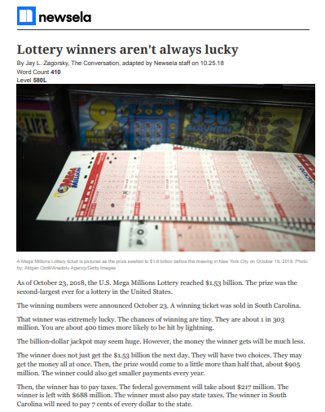
Speculating
K- 2
Newsela Articles Check Lexile Levels!

Slide 7
Borrowing
K- 2
Lesson 6: Borrowing Bills

Slide 8
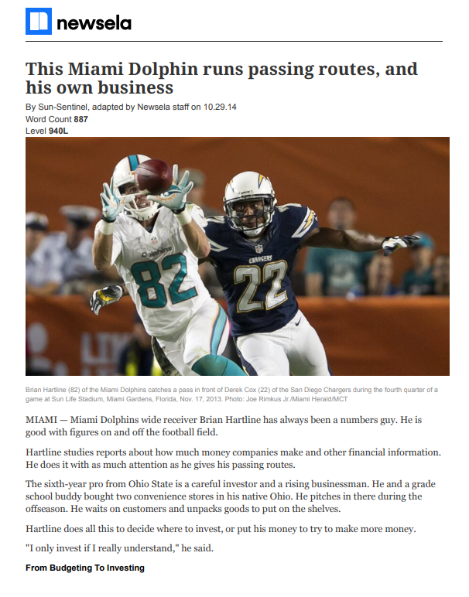
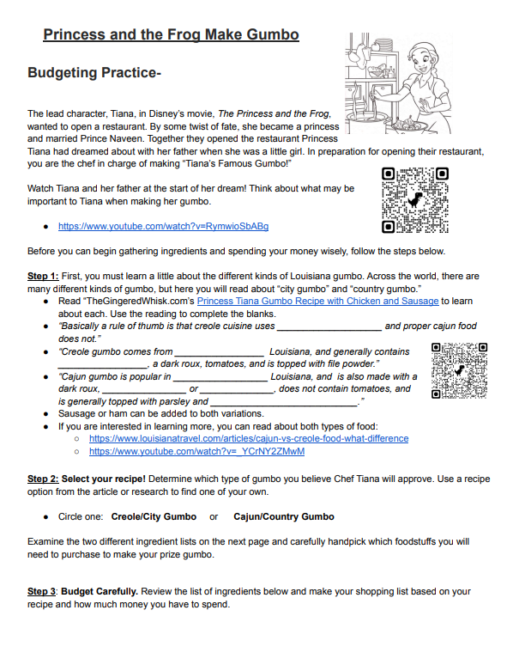
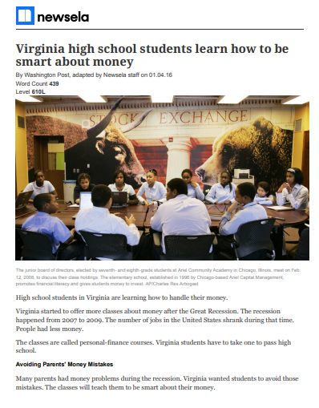
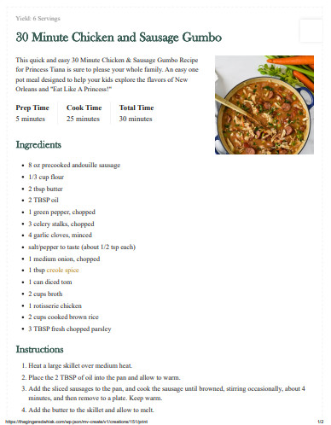
Budgeting
3-5
Newsela Articles Check Lexile Levels!
Princess and the Frog Make Gumbo
The Gingered Whisk

Slide 9
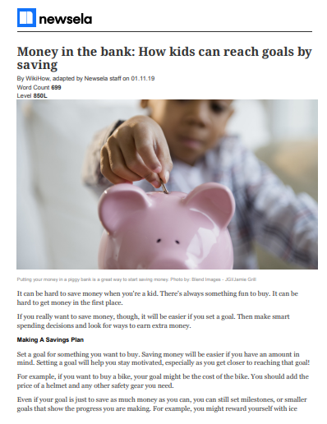
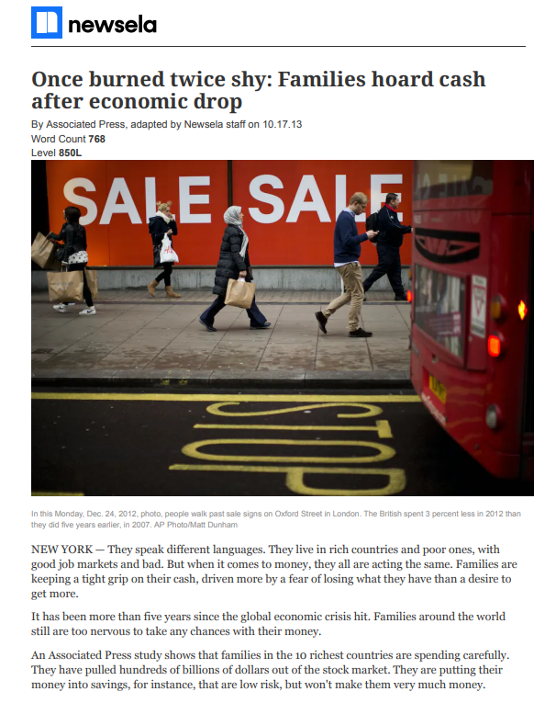
Saving
3-5
Newsela Articles Check Lexile Levels!

Slide 10
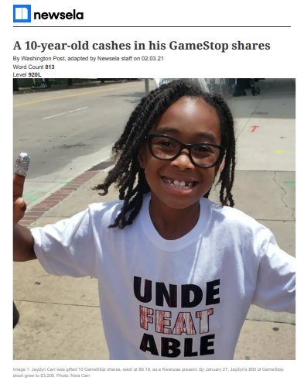
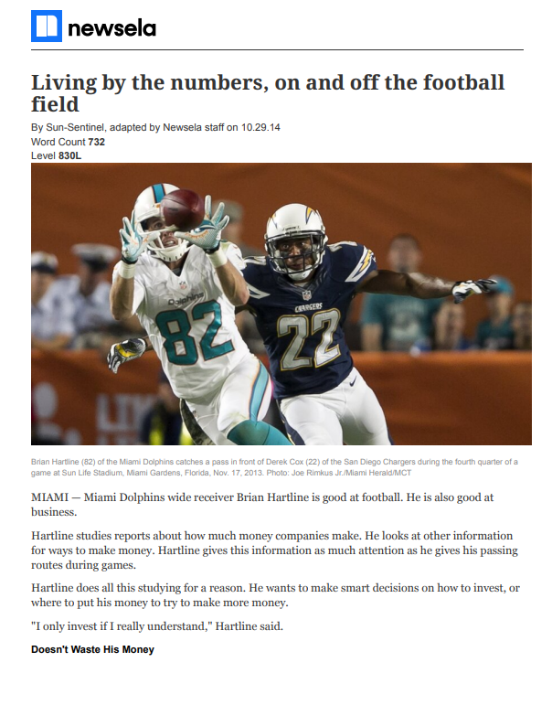
Investing
3-5
Newsela Articles Check Lexile Levels!

Slide 11
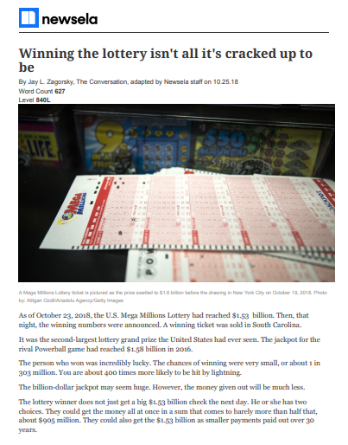
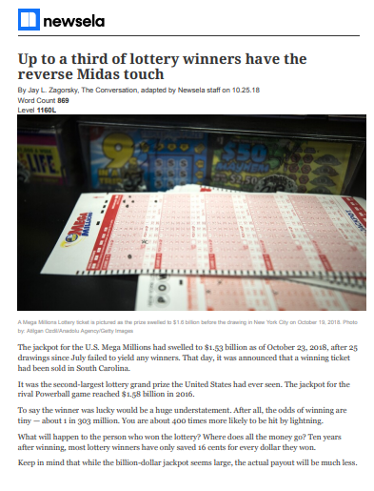
Speculating
3-5
Newsela Articles Check Lexile Levels!

Slide 12
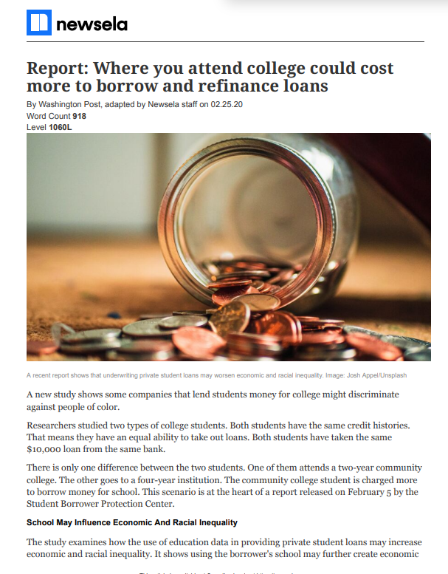
Borrowing
3-5
Newsela Articles Check Lexile Levels!

Slide 13
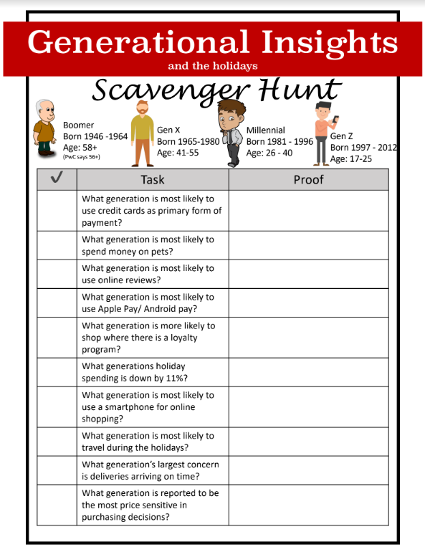
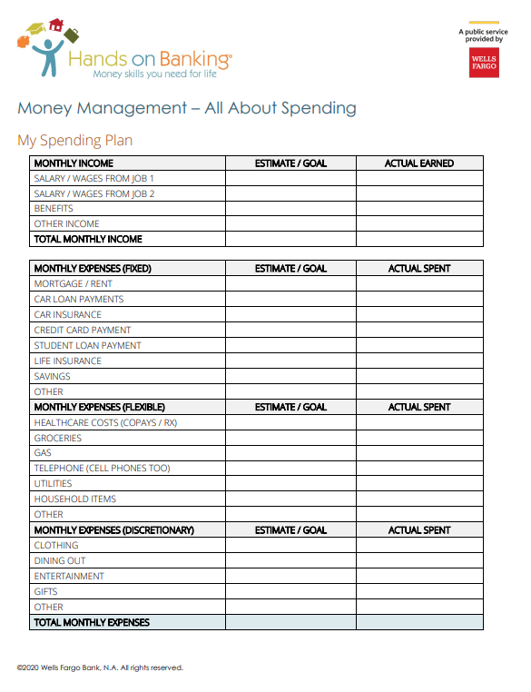
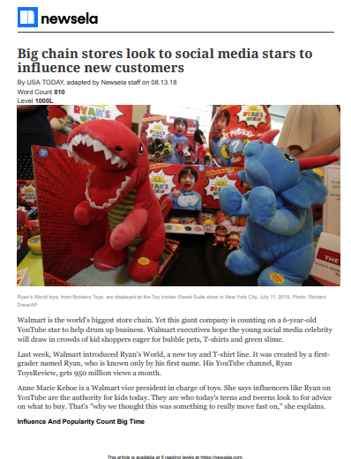
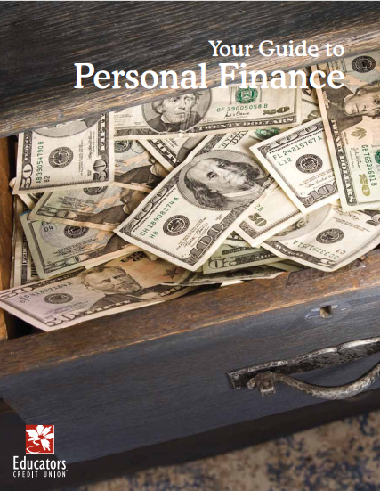
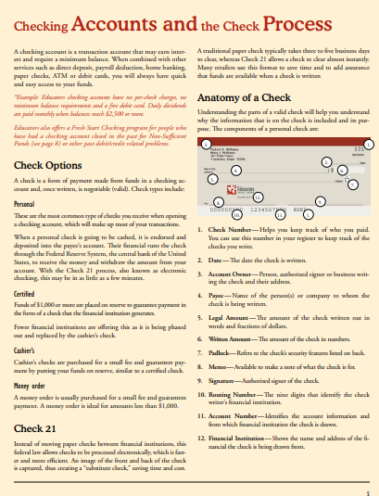
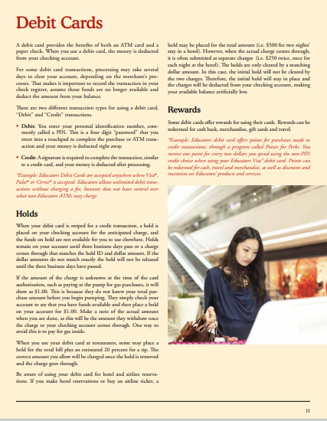
Budgeting
6-8
Generational Insights Link to Lesson HERE
PwC Holiday Outlook 2022 Generational insights Link HERE
Princess and the Frog Make Gumbo
The Gingered Whisk
Check Accounts
Debit Cards
Hands On Banking Budget - Spending Plan
Newsela Articles
Nearpod PDF
Check Lexile Levels!

Slide 14
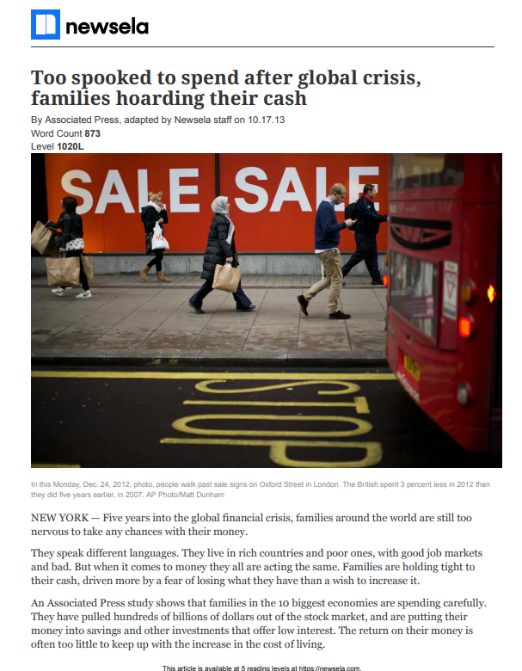
Saving
6-8
Newsela Articles Check Lexile Levels!

Slide 15
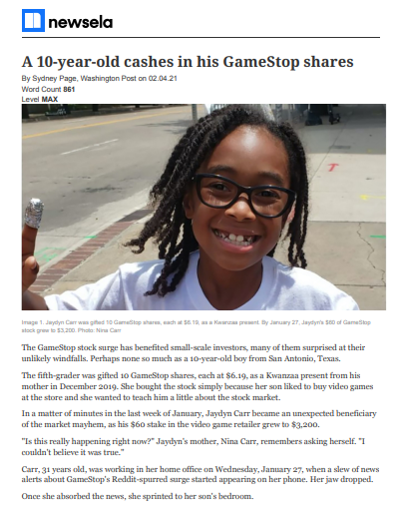
Investing
6-8
Newsela Articles Check Lexile Levels!

Slide 16
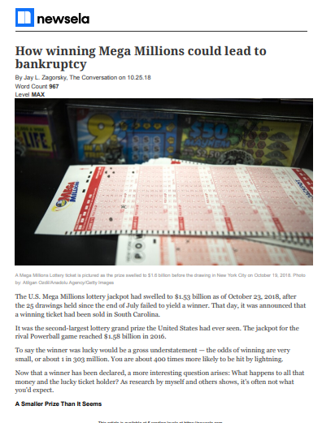
Speculating
6-8
Newsela Articles Check Lexile Levels!

Slide 17
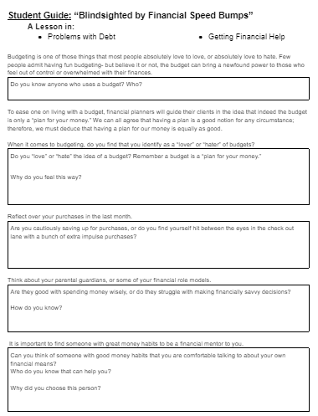
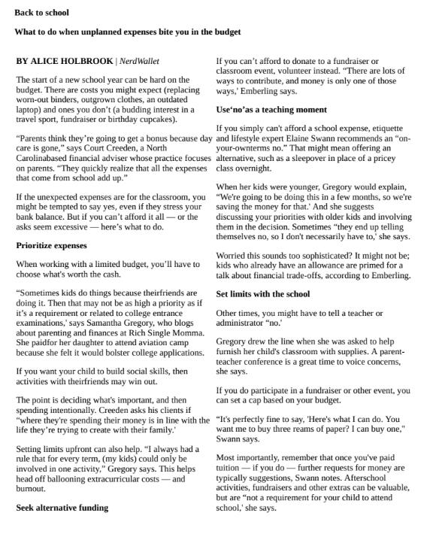
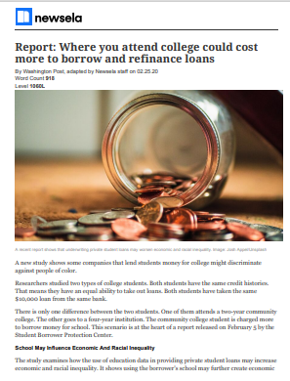
Borrow
6-8
Student Guide: “Blindsighted by Financial Speed Bumps”
Back to school
Newsela Articles Check Lexile Levels!

Slide 18
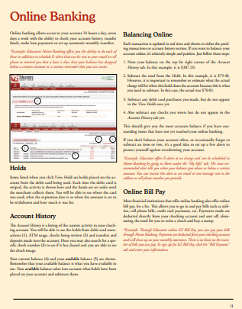
Budgeting
9-10
Generational Insights Link to Lesson HERE
PwC Holiday Outlook 2022 Generational insights Link HERE
Princess and the Frog Make Gumbo
The Gingered Whisk
Check Accounts
Debit Cards
Hands On Banking- Budget Plan
Newsela Articles
Nearpod PDF
Check Lexile Levels!

Slide 19
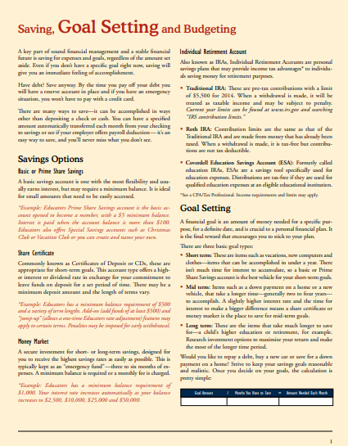
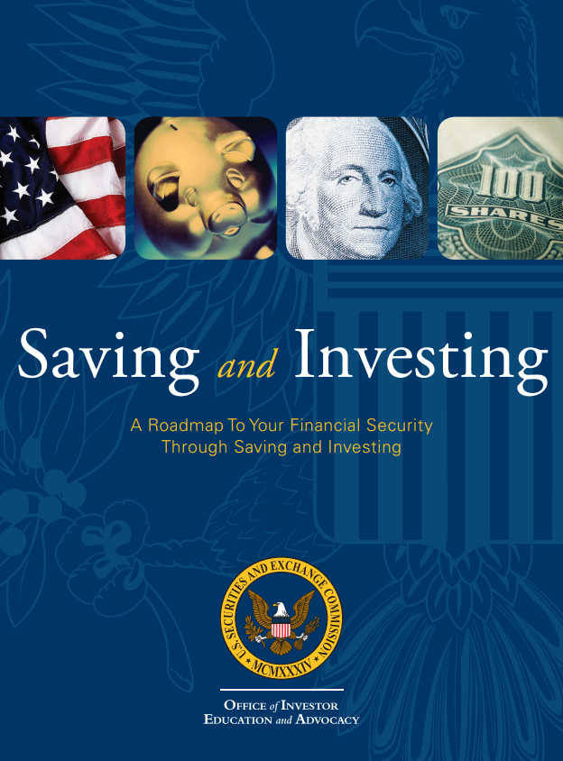
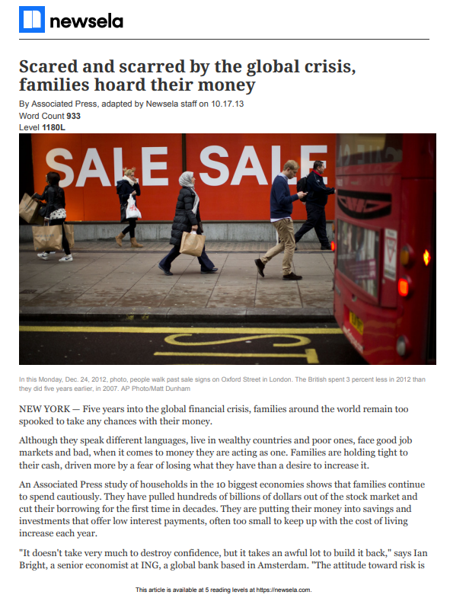
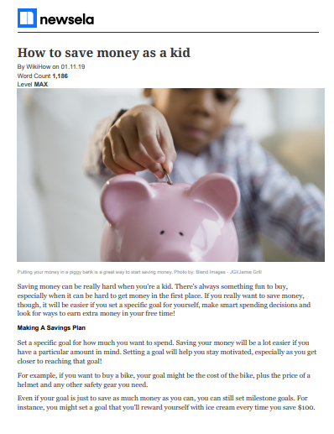
Saving
9-10
Saving, Goal Setting and Budgeting
SEC Saving and Investing
Newsela Articles

Slide 20
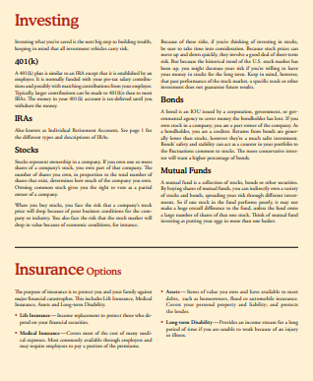
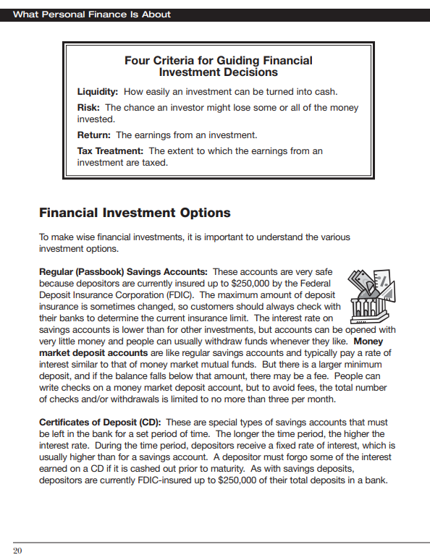
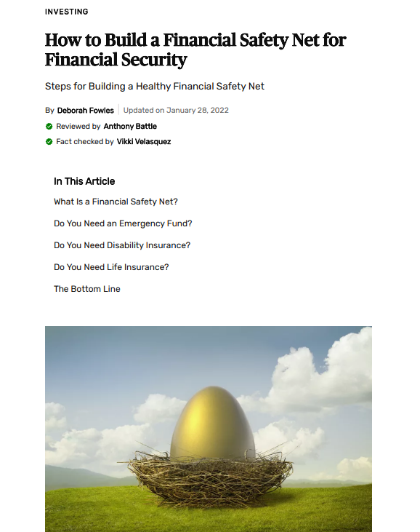
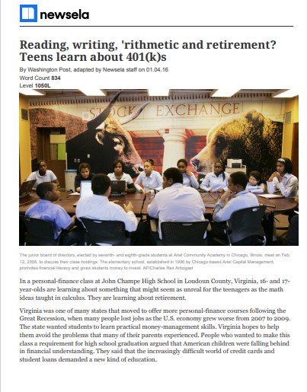
Investing
9-10
Investing and Insurance
Investing and Risk
How to Build a Healthy Financial Safety Net For Financial Security
Newsela Articles

Slide 21
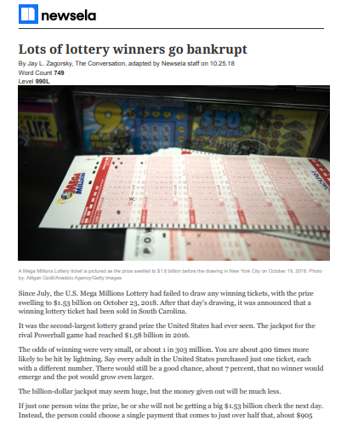
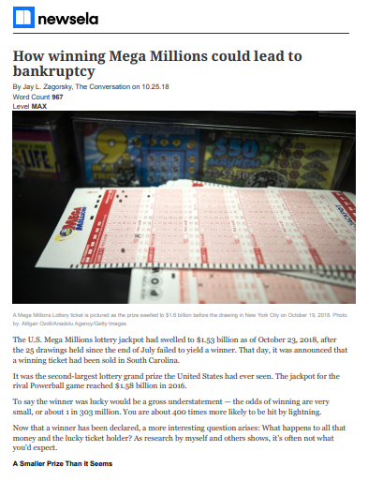
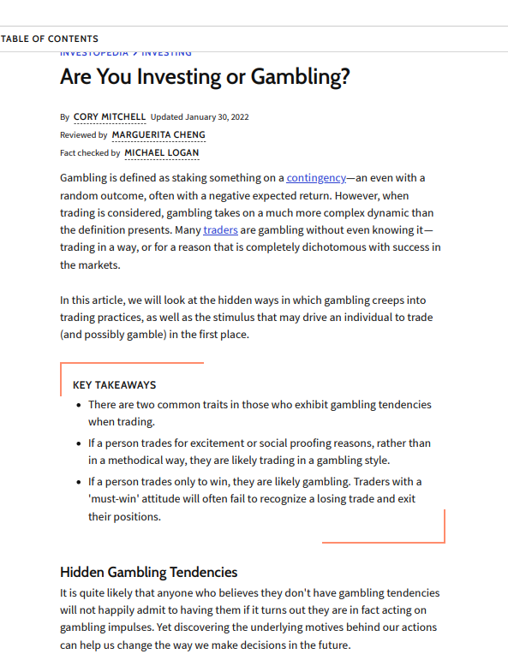
Speculating
9-10
Are You Investing or Gambling?
Newsela Articles Check Lexile Levels!

Slide 22
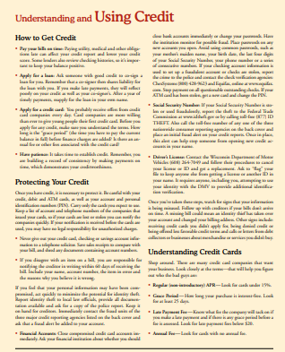
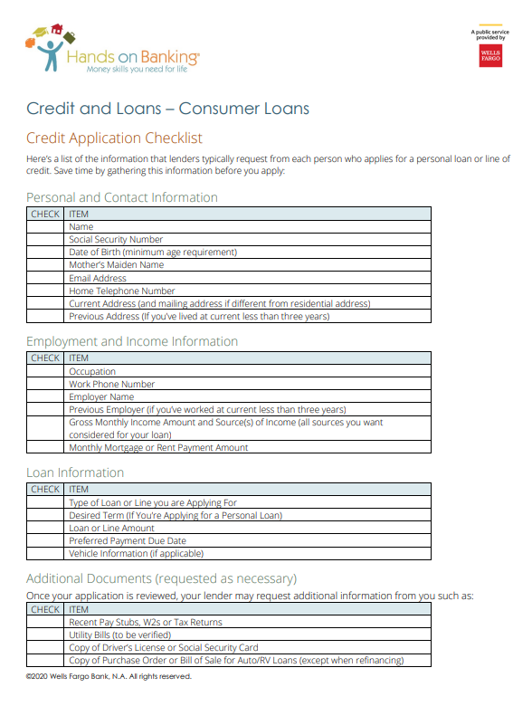
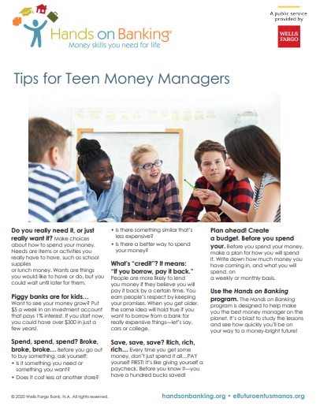
Borrowing
9-10
Understanding and Using Credit
What About Using Credit Cards
Newsela Articles Check Lexile Levels!
Credit Application Checklist
Tips for Teen Money Managers
What About Using Credit Cards
Newsela Articles

Slide 23
Budgeting
11-12
Generational Insights Link to Lesson HERE
PwC Holiday Outlook 2022 Generational insights Link HERE
Princess and the Frog Make Gumbo
The Gingered Whisk
Check Accounts
Debit Cards
Hands On Banking- Budget Plan
Newsela Articles
Nearpod PDF
Check Lexile Levels!

Slide 24
Saving
11-12
Saving, Goal Setting and Budgeting
SEC Saving and Investing
Newsela Articles Check Lexile Levels!

Slide 25
Investing
11-12
Investing and Insurance
Investing and Risk
How to Build a Healthy Financial Safety Net For Financial Security
Newsela Articles Check Lexile Levels!

Slide 26
Speculating
11-12
Are You Investing or Gambling?

Slide 27
Borrowing
11-12
Understanding and Using Credit
What About Using Credit Cards
Newsela Articles Check Lexile Levels!
Credit Application Checklist
Tips for Teen Money Managers
What About Using Credit Cards
Newsela Articles

Slide 28
Standards:
Personal Financial Literacy Standards

Slide 29
Find Out More!

Slide 30
Stay Up To Date!

Slide 31
Scroll Down to Register:

Slide 32
Want MORE???
Stavros Center Resources

Slide 33
Brittany Sampson
bsampson@usf.edu

