Slide 1
USF Stavros Center Presents:
NIGHT AT THE VIRTUAL MUSEUM
Corporate Era: 1860s to 1930s
Deborah Kozdras dkozdras@usf.edu
Tinyurl.com/usfstavrosresources

Slide 2
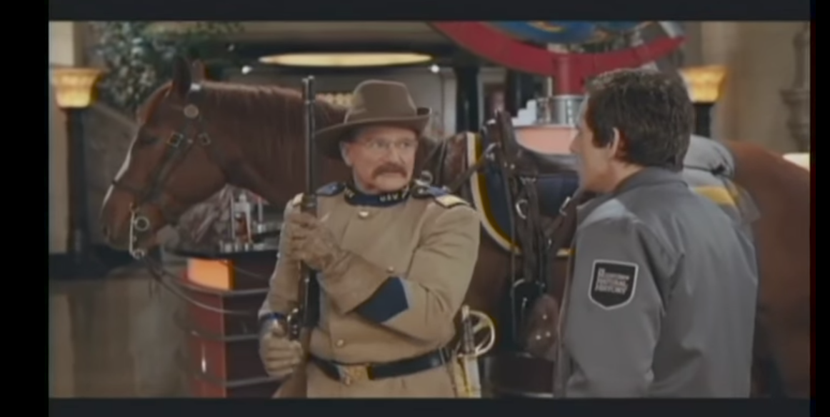
https://www.youtube.com/watch?v=kYGCCboJW-c Intro meets

Slide 3
Historical Literacy
SS.912.A.1.2 Utilize a variety of primary and secondary sources to identify author, historical significance, audience, and authenticity to understand a historical period.
SS.912.A.1.3 Utilize timelines to identify the time sequence of historical data.
SS.912.A.1.4 Analyze how images, symbols, objects, cartoons, graphs, charts, maps, and artwork may be used to interpret the significance of time periods and events from the past.
SS.912.A.1.5 Evaluate the validity, reliability, bias, and authenticity of current events and Internet resources.
SS.912.A.1.6 Use case studies to explore social, political, legal, and economic relationships in history.
SS.912.A.1.7 Describe various socio-cultural aspects of American life including arts, artifacts, literature, education, and publications.

Slide 4
Industrial Revolution
SS.912.A.3.1Analyze the economic challenges to American farmers and farmers' responses to these challenges in the mid to late 1800s.
SS.912.A.3.10 Review different economic and philosophic ideologies.
SS.912.A.3.2Examine the social, political, and economic causes, course, and consequences of the second Industrial Revolution that began in the late 19th century.
SS.912.A.3.3 Compare the first and second Industrial Revolutions in the United States.
SS.912.A.3.4 Determine how the development of steel, oil, transportation, communication, and business practices affected the United States economy.
SS.912.A.3.5 Identify significant inventors of the Industrial Revolution including African Americans and women.
SS.912.A.3.6 Analyze changes that occurred as the United States shifted from agrarian to an industrial society.
SS.912.A.3.9 Examine causes, course, and consequences of the labor movement in the late 19th and early 20th centuries.

Slide 5
Roaring Twenties
SS.912.A.5.10 Analyze support for and resistance to civil rights for women, African Americans, Native Americans, and other minorities.
SS.912.A.5.4 Evaluate how the economic boom during the Roaring Twenties changed consumers, businesses, manufacturing, and marketing practices.

Slide 6
Economic Questions
What was produced?
How was it produced?
How did what was produced get allocated?
Or . . . Just ask . . .why?

Slide 7
Economic vs Economic Historic Thinking
Economics
Economic Historians
Economists practice something few historians do look to the future and predict
Economists isolate independent variables to find regularities that predict
Historians don’t try to predict the future.
Historians feel that isolating variables is unattainable because all variables are interdependent. They consider as many variables as possible.

Slide 8
https://www.youtube.com/watch?v=Xac4Px49Tfo
How will you be great? How can you solve problems of the corporate era?

Slide 9
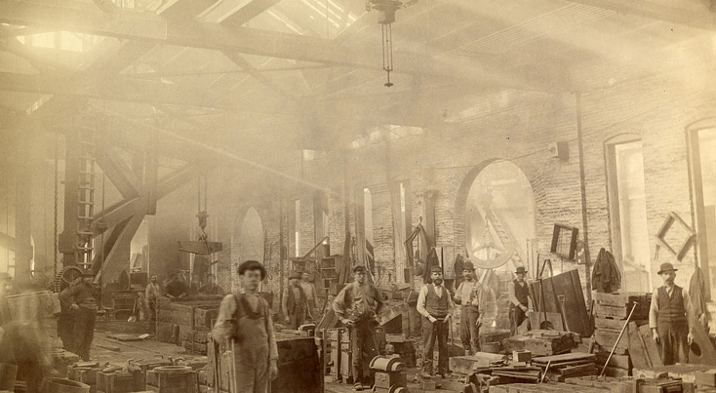
Corporate Era: 1860s to 1930s
http://americanhistory.si.edu/american-enterprise-exhibition/corporate-era

Slide 10
Debating Enterprise: Private Gain vs Public Good
Andrew Carnegie
Louis Brandeis
Theodore Roosevelt

Slide 11
Debating Enterprise: Private Gain vs Public Good

Slide 12
Debating Enterprise: Private Gain vs Public Good

Slide 13
Debating Enterprise: Private Gain vs Public Good

Slide 14
Explore Find Evidence: Through the different topics
Andrew Carnegie: Competition strengthens the country | Louis Brandeis: The wealthy few will overwhelm the rights of the many | Theodore Roosevelt: Government needed to regulate big business

Slide 15
Building an Argument
Main Idea
Here is what I think . . .
Counter
Arguments
Evidence to back up my reasons
Here are my reasons!
___________________________________________________
___________________________________________________
___________________________________________________
You could argue that…
_________________________________________________________________________________________________________
. . .but here is the weakness . . .
_______________________________________________________________
Strong Finish!
__________________________________________________________________________________________________________________________________________
CON
When you weigh all the evidence
you conclude that . . .
PRO

Slide 16
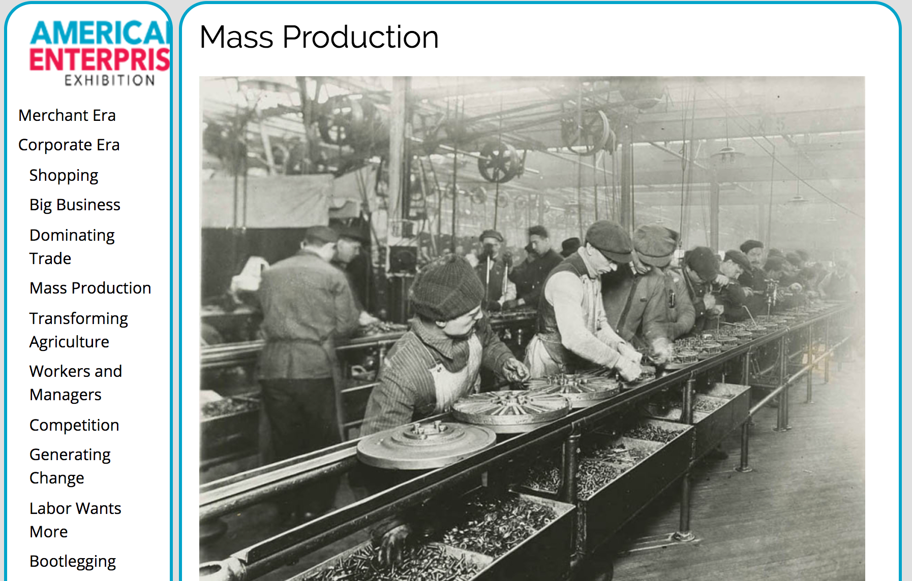
What was the impact of mass production?

Slide 17
What were the relationships between workers and managers?

Slide 18
United We Stand, Divided We Fall
Factors that united them
Factors that divided them

Slide 19
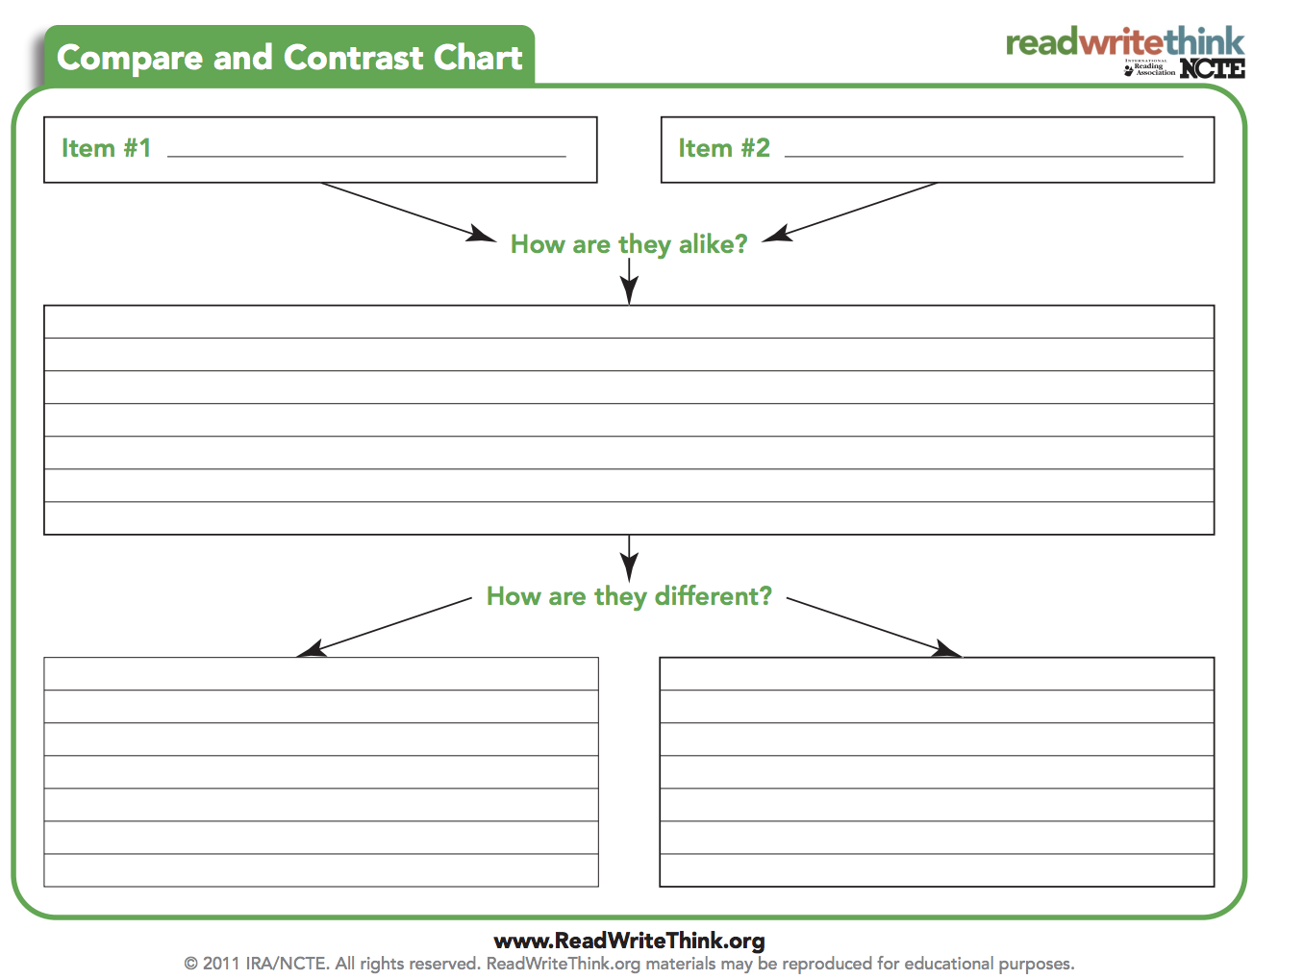
How did agriculture change from 1800’s to 1920?
Oliver plow, 1877
Fordson tractor, 1918

Slide 20
Worker Rights: Support for and Resistance to
SS.912.A.5.10 Analyze support for and resistance to civil rights for women, African Americans, Native Americans, and other minorities.

Slide 21
What about Competition?

Slide 22
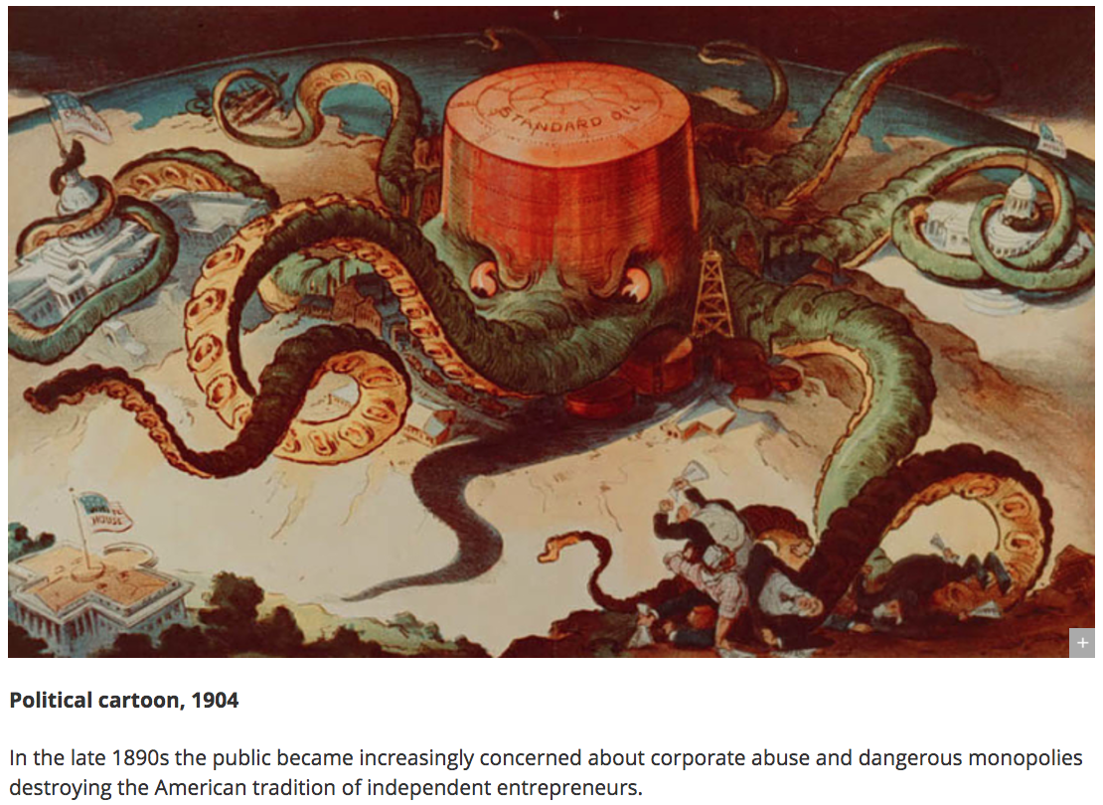
What were some problems during the corporate era?

Slide 23
http://www.loc.gov/teachers/usingprimarysources/resources/Analyzing_Political_Cartoons.pdf

Slide 24
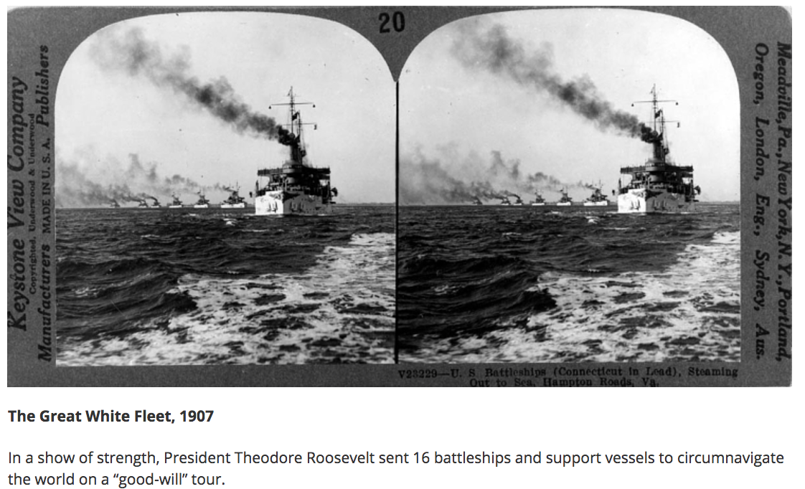
Dominating Trade: Then and Now
http://americanhistory.si.edu/american-enterprise-exhibition/corporate-era/dominating-trade
http://americanhistory.si.edu/american-enterprise-exhibition/corporate-era/dominating-trade

Slide 25
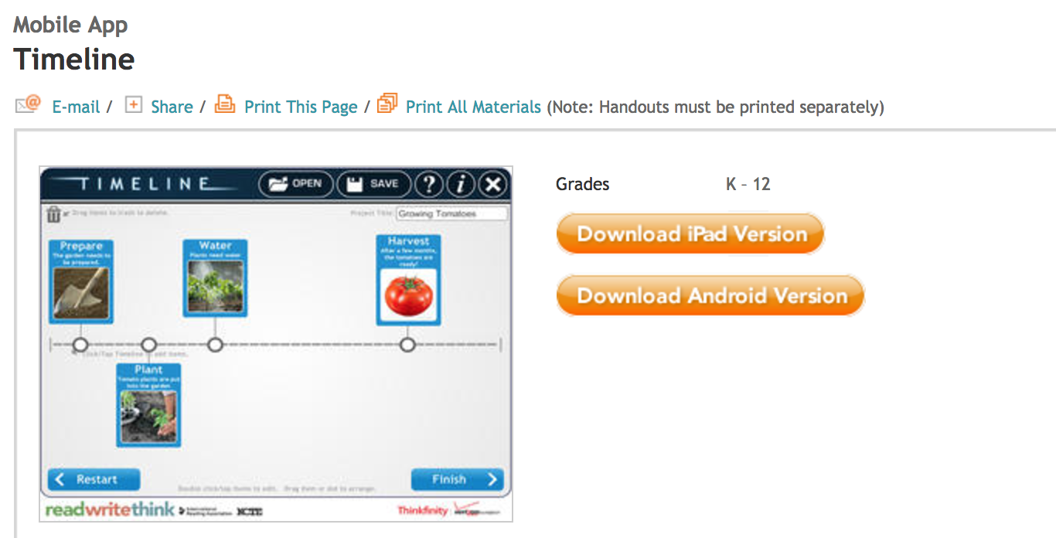
http://www.readwritethink.org/classroom-resources/mobile-apps/timeline-b-31047.html

Slide 27
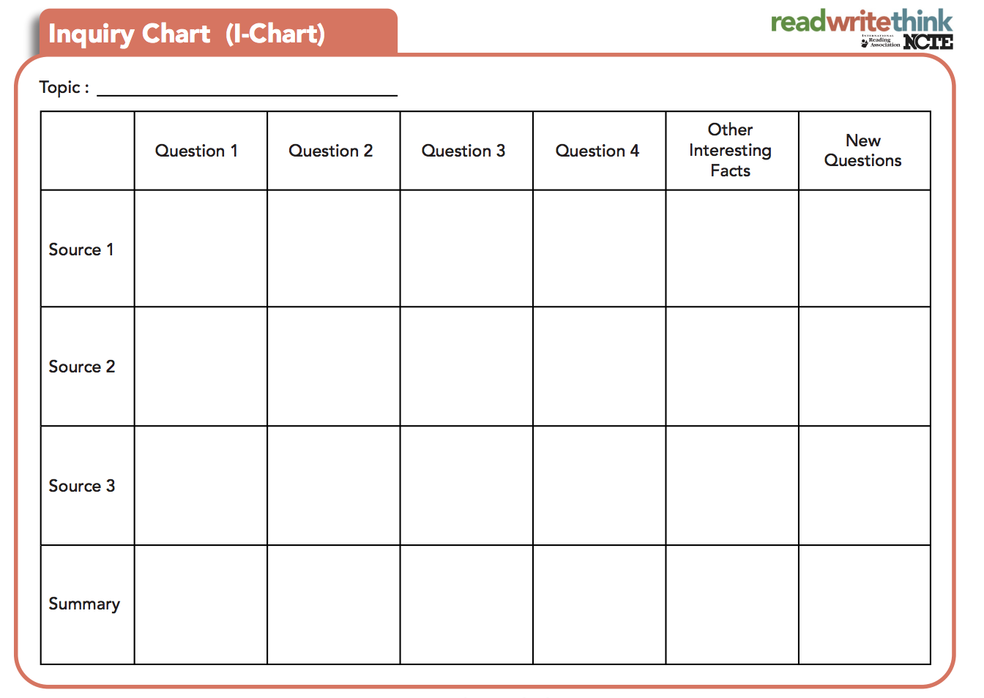
http://www.readwritethink.org/professional-development/strategy-guides/inquiry-charts-charts-30762.html
http://www.readwritethink.org/professional-development/strategy-guides/inquiry-charts-charts-30762.html

Slide 28
Generating Change
https://www.youtube.com/watch?v=xHC5jdXFmGQ Invent with Teddy

Slide 29
Generating Change: I wonder why they chose this image?
http://americanhistory.si.edu/american-enterprise-exhibition/corporate-era/generating-change

Slide 31
Innovation to Market Simulation: http://americanhistory.si.edu/american-enterprise-exhibition/simulations/innovation-market

Slide 32
Inventors
http://americanhistory.si.edu/american-enterprise-exhibition/videos/men-progress
http://amhistory.si.edu/american-enterprise/innovation-to-market/
https://www.uspto.gov/kids/index.html
https://www.uspto.gov/kids/index.html

Slide 33
Men of Progress http://americanhistory.si.edu/american-enterprise-exhibition/videos/men-progress

Slide 34
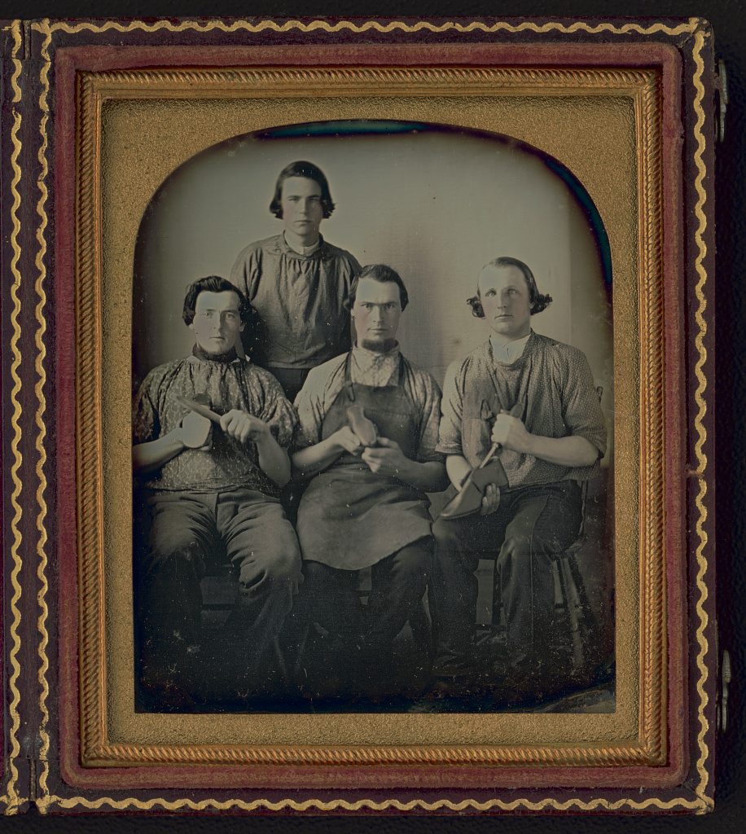
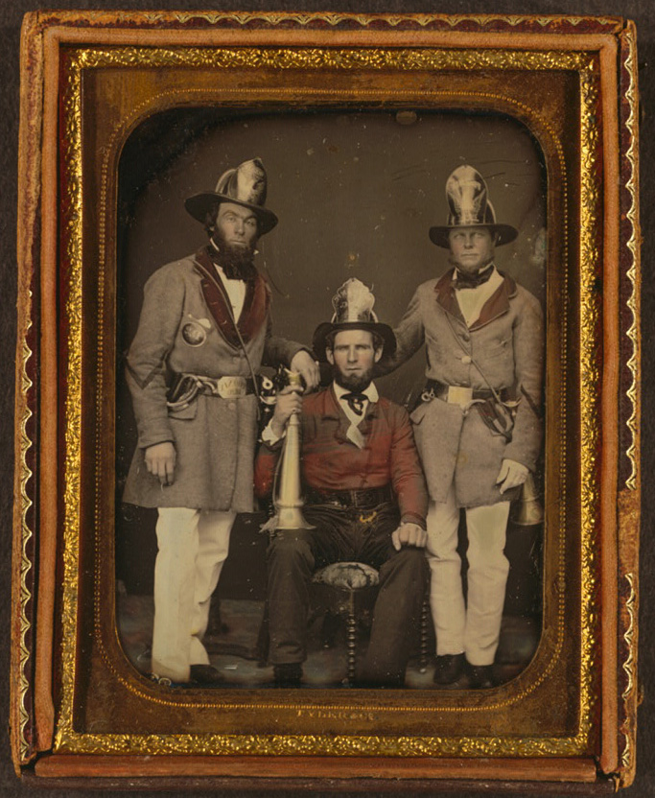
Occupational Portraits
http://blogs.loc.gov/picturethis/2017/10/profiling-portraits-occupational-portraits-of-the-19th-century/?loclr=eaptb

Slide 35
Biographies http://americanhistory.si.edu/american-enterprise-exhibition/corporate-era/biographies-1860s%E2%80%931930s
Addie Card: Child Laborer
Madame C. J. Walker: Hair Care Millionaire

Slide 36
Labor Leaders http://americanhistory.si.edu/american-enterprise-exhibition/videos/labor-leaders

